Slide 1

Module 10: Fatigue Monitoring and Management Technologies
Notes:
Narration: This is north American Fatigue Management program Module 10 - Fatigue Monitoring and Management Technologies.

Slide 2
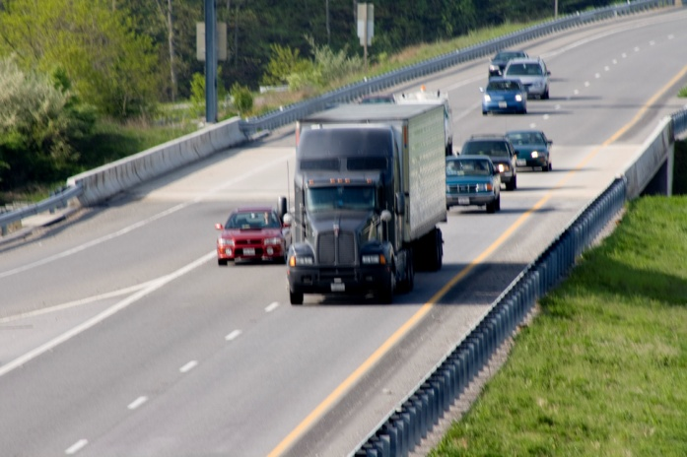
Module 10 Overview
The Why, What, & How of Fatigue Management Technologies
Sample of Current Technologies
Deployment Considerations & Operational Guidelines
Review & Summary
Notes:
Narration: Module 10 will last approximately one hour and will consist of four lessons:
Lesson 1: The Why, What, & How of Fatigue Management Technologies
Lesson 2: Sample of Current Technologies
Lesson 3: Deployment Considerations & Operational Guidelines
and
Lesson 4: Wrap-up & Review

Slide 3
Common FMT Acronyms
IR – Infrared
LCD – Liquid crystal display
LDWS – Lane Departure Warning System
LED – Light emitting diode
OEM – Original equipment manufacturer
Perclos – Percent eye closure
PLM – Periodic leg movement
PVT – Psychovigilance test
ROI – Return on investment
TIM – Truck interface module
VMT – Vehicle miles traveled
Notes:
Narration: This is a list of some of the most common acronyms you may encounter when dealing with fatigue management technologies. You may wish to print this slide as a quick reference while you are taking this training module.
_______________________
Key points:
You may wish to print this slide as a quick reference while you are taking this training module

Slide 4
Module 10 Objectives
Define and identify FMTs and their role within an overall safety culture
Discern the difference between the different classifications of FMTs and a multi-channel versus single channel approach
Identify a sample of common currently available FMTs and their general specifications
Understand the considerations for implementing FMTs including cost, return on investment (ROI), protocols for use, performance measures, training, and driver acceptance
Understand the fundamental technology issues with FMT efficacy
Understand FMTs must be used within an overall Fatigue Management Program (FMP)
Notes:
Narration: Module 10 will consist of six learning objectives. These objectives are:
Define and identify fatigue management technologies and their role within an overall safety culture;
Discern the difference between the different classifications of fatigue management technologies and a multi-channel versus single channel approach;
Identify a sample of common currently available fatigue management technologies and their general specifications;
Understand the considerations for implementing fatigue management technologies including cost, return on investment, protocols for use, performance measures, training, and driver acceptance;
Understand the fundamental technology issues with fatigue management technology efficacy; and
Understand fatigue management technologies must be used within an overall fatigue management program.
___________
Key points:
After this module, you will be able to……

Slide 5
Lesson 1: The Why, What, and How of Fatigue Management Technologies
Notes:
Narration: Lesson 1 will cover The Why, What, and How of Fatigue Management Technologies.
___________________________
Key Points Overview:
Why: Understanding the problem and some statistics
What: FMTs and their classifications
How: The concepts behind FMTs
Single versus multi-channel systems
Making sense of FMTs
No Silver Bullet

Slide 6
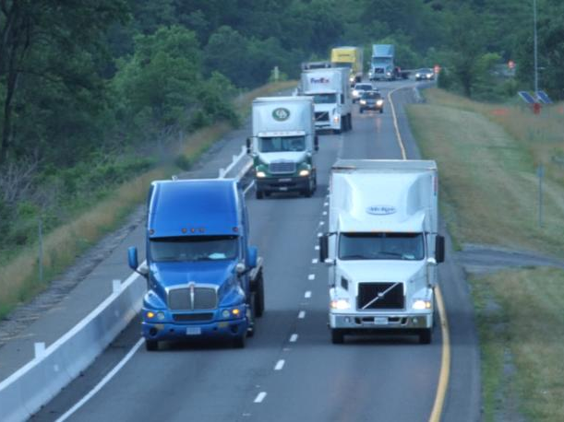
Why? Understanding the Problem
Fatigue impairs and degrades driving performance by changing driver behavior:
  Fatigue leads to errors
Fatigue risk factors for CMV drivers
  Varying work schedules
  Irregular shifts (e.g., night driving)
  Long, monotonous driving conditions (e.g., interstates)
Although the impact is clear, fatigue is often under represented in crash statistics
Notes:
Narration: Research has shown fatigue impairs and degrades driving performance by changing driver behavior. To put it plain and simple fatigue leads to driver errors. A number of risk factors contribute to fatigue for CMV drivers. These risk factors include varying work schedules, irregular shifts such as night driving, and long, monotonous driving conditions such as interstates. Fatigue is often underrepresented in crash statistics.

Slide 7
Why? The Statistics
Statistics suggest fatigue is an important safety issue
  Large Truck Crash Causation Study
    ~4% of truck crashes have primary cause by driver asleep-at-the-wheel
    ~13% of truck crashes involved driver fatigue as associated factor
  Of 182 fatal-to-the-driver truck crashes investigated in 1990 by the National Transportation Safety Board, fatigue was the primary factor in 31% of the crashes
  Australian research revealed truck drivers with less than six hours of sleep were three times more likely to have a hazardous incident
Notes:
Narration: Statistics suggest fatigue is an important safety issue. The Large Truck Crash Causation Study conducted by the Federal Motor Carrier Safety Administration has shown approximately 4% of truck crashes are primarily caused by the driver asleep-at-the-wheel and approximately 13% of truck crashes involved driver fatigue as an associated factor.
Also, of 182 fatal-to-the-driver truck crashes investigated in 1990 by the National Transportation Safety Board, fatigue was the primary factor in 31% of the crashes.
Additionally, Australian research revealed truck drivers with less than six hours of sleep were three times more likely to have a hazardous incident.

Slide 8
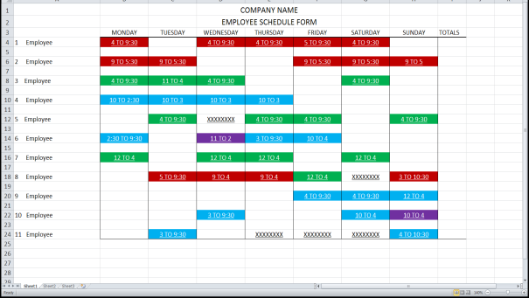
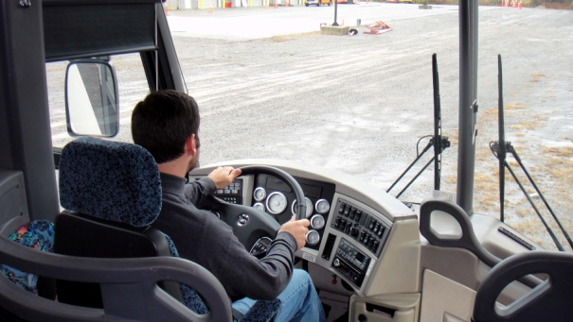
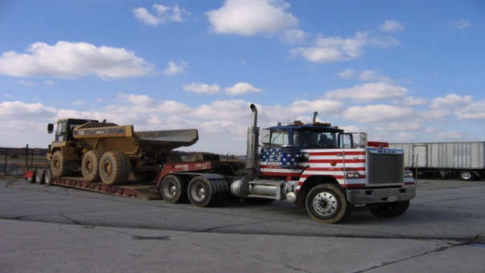
What? Fatigue Management Technologies
State-of-the-art innovations that prevent, identify, alert, and reduce driver fatigue and fatigue related driving errors
FMTs use three points-of-attack
  Non-driver measures
  Driver physiological measures/psychomotor skills
  Vehicle kinematics/driver input
Notes:
Narration: Fatigue management technologies are state-of-the-art innovations that prevent, identify, alert, and reduce driver fatigue and fatigue related driving errors. These technologies use three points-of-attack: non-driver measures (for example, fatigue modeling), driver physiological measures/psychomotor skills (for example, eye tracking), and vehicle kinematics/driver input (for example, lane keeping).

Slide 9
What? FMT Classifications
FMTs are developed in two principal classification levels
  Back-Office Level
  Driver Level
Within each of the classifications there are two sub-sets of FMTs
  In-Vehicle
  Out-of-Vehicle
Notes:
Narration: Fatigue management technologies are developed in two principal classification levels: the back-office level and the driver level. Within each of these principle classification levels there are two sub-sets of fatigue management technologies: in-vehicle and out-of-vehicle. One should keep in mind that some overlap within the classification levels may occur.

Slide 10
What? FMT Primary Relationships
Back-Office Level
Driver Level
Vehicle Kinematics
&
Driver Input
Driver Physiological Measures
&
Psychomotor Skills
Non-driver measures
Notes:
Narration: This Venn diagram shows the relationships between the different fatigue management technology concepts and which principal classification level they can be found in. Notice that driver physiological measures and psychomotor skills can be found in both back-office level and driver level.

Slide 11
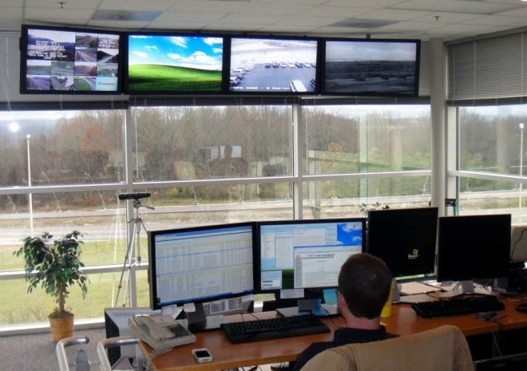
What? Back-Office Level FMTs
(1 of 3)
The first line of defense against driver fatigue
  Aimed at prevention
Key personnel involved
  Transportation directors
  Safety managers
  Dispatchers
  Driver trainers
  Medical staff
  Office personnel
Notes:
Narration: Back-office level fatigue management technologies are the first line of defense against driver fatigue. These technologies are aimed at prevention. Many personnel are involved in the back-office level. The key personnel include transportation directors/executives, safety managers, dispatchers, driver trainers, medical staff, and other office personnel.

Slide 12
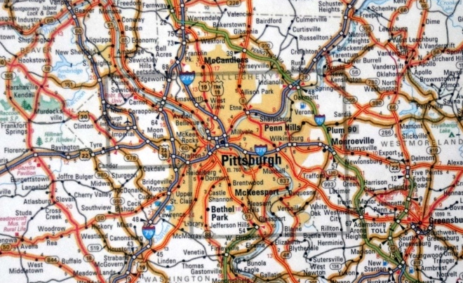
What? Back-Office Level FMTs
(2 of 3)
Out-of-vehicle FMTs
  Occur prior to a driver beginning a shift
  Non-driver measures (e.g., scheduling)
  Driver physiological measures/psychomotor skills
Out-of-vehicle FMT descriptions
  Driver scheduling software
  Trip planning/routing software
  Fit-for-duty testing
Notes:
Narration: Back-office level fatigue management technologies that occur out-of-vehicle include non-driver measures, driver physiological measures, and psychomotor skills. These types of technologies occur before a driver begins his/her shift. A few examples of out-of-vehicle back-office level fatigue management technologies are driver scheduling software, trip planning/routing software, and fit-for-duty testing.

Slide 13

What? Back-Office Level FMTs
(3 of 3)
In-vehicle technologies
  Designed to monitor driver and roadway with video
  Some systems include data from vehicle (i.e., speed, braking, GPS)
  Video and data are collected then evaluated
Risky driving behavior reviewed and analyzed
Driver coaching and training
Notes:
Narration: Back-office level fatigue management technologies that are found in-vehicle are systems designed to monitor the driver and roadway with video. Additionally, some of these systems also record data from the vehicle network such as speed, braking, and GPS. The video and data are collected, transferred by vehicle telemetry or wireless internet and then evaluated. The video and data are reviewed and analyzed. This process is handled either by a third party or within the fleet depending on the system that is being employed. Risky driving behavior is flagged for review with the driver for coaching and training. Driver coaching and training is carried out based on company policy. In general these systems are referred to as behavior-based coaching systems (for example, DriveCam, which is discussed later).
___________________
Key Points:
These systems are behavior-based coaching systems (e.g., DriveCam, discussed later).
Review and analysis of risky driving behavior is handled by a third party or within the fleet itself depending on the system.
Driver coaching and training performed based on carrier training policy.

Slide 14
What? Driver Level FMTs (1 of 3)
The final line of defense against driver fatigue
  Identify and alert driver of impending fatigue
Pre-drive monitoring
  Driver physiological measures/psychomotor skills
Real time driver monitoring
  Last stop-gap countermeasure
  Driver physiological measures/psychomotor skills
  Vehicle kinematics/driver input
Notes:
Narration: Driver Level fatigue management technologies are the final line of defense against driver fatigue. These technologies are designed to identify and alert the driver of impending fatigue to reduce risky driving behaviors, performance degradation, and driver errors. Driver level technologies can be found both out-of-vehicle and in-vehicle. Pre-drive monitoring occurs out-of-vehicle and uses physiological measures and/or psychomotor skills. Real time driver monitoring occurs in-vehicle and uses either physiological measures, psychomotor skills, vehicle kinematics, or driver input. Real time driver monitoring is the last stop-gap countermeasure as this is the last alert to warn the driver before potential risky driving behavior or a crash could occur.
_____________________
Key Points:
To reduce risky driving behaviors, performance degradation, and driver errors related to fatigue.
Pre-drive monitoring occurs out-of-vehicle.
Real time driver monitoring occurs in-vehicle.
In-vehicle driver monitoring is the last alert to warn the driver before potential risky driving behavior or a crash could occur.

Slide 15
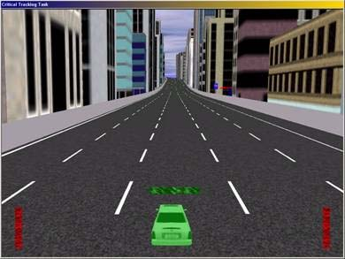
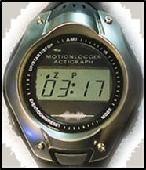
What? Driver Level FMTs (2 of 3)
Out-of-vehicle FMTs
  Prior to driving shifts
    Fitness-for-duty testing
    Actigraphy
Notes:
Narration: Driver level fatigue management technologies occurring out-of-vehicle are typically conducted prior to a driver beginning his/her driving shift. These types of technologies include fitness-for-duty testing and actigraphy. Both of these technologies will be discussed in further detail later in this training module.

Slide 16
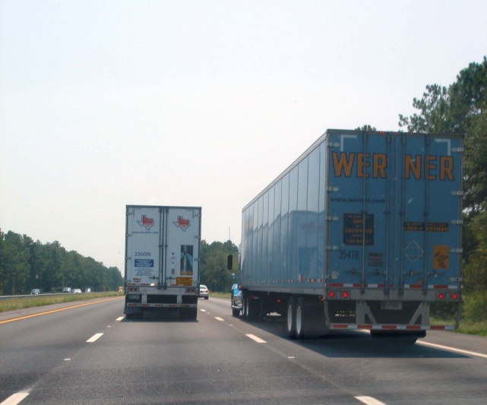
What? Driver Level FMTs (3 of 3)
In-vehicle FMTs
  Continual monitoring with feedback and alerts
In-vehicle FMTs descriptions
  Eye measurements
  Lane monitoring
  Steering input
  Reaction time
  Actigraphy
Notes:
Narration: Driver level fatigue management technologies occurring in-vehicle continually monitor the driver and provide feedback and alerts. In-vehicle technologies can include eye measurements, lane monitoring, steering input, reaction time, and actigraphy. Each of these technologies will be discussed in further detail later in the training module.

Slide 17

How? Conceptual Foundation of FMTs
A number of conceptual ideas form the backbone of FMT development
  Physiological measures
  Psychomotor skills
  Behavior-based coaching
  Vehicle kinematics/driver input
  Single versus multi-channel systems
Notes:
Narration: You will learn a number of conceptual ideas that form the backbone of fatigue management technology development: physiological measures, psychomotor skills, behavior-based coaching, vehicle kinematics, and driver input. Additionally single-channel versus multi-channel systems will be discussed.

Slide 18
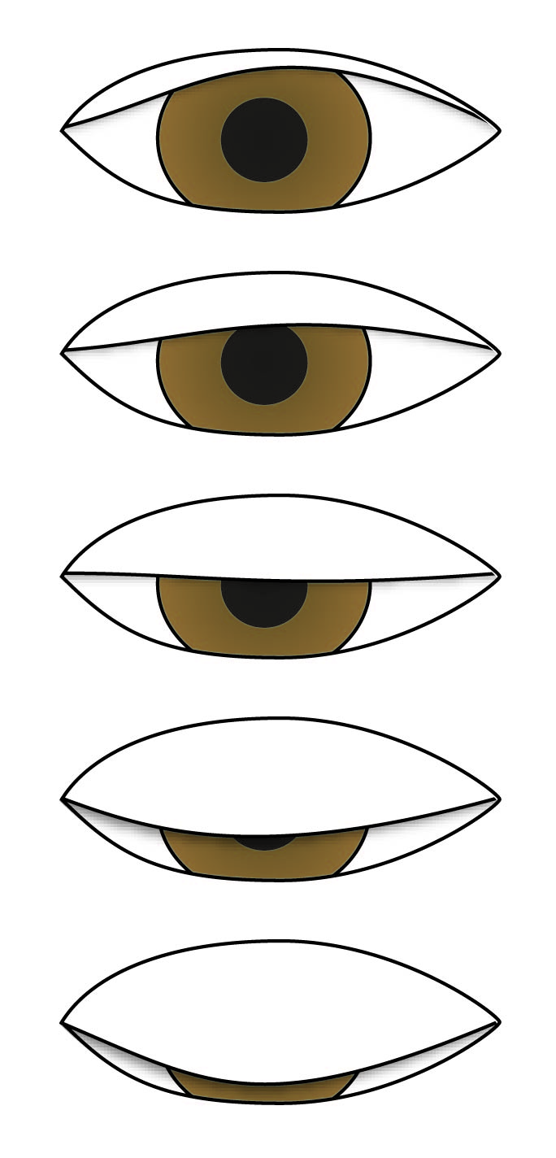
How? Physiological Concepts
(1 of 3)
Eye (ocular) measures
  Perclos
    Percent closure of the driver’s eyelids
  Amplitude Velocity Ratio
    How fast and how far the eyelid opens after closure
Notes:
Narration: Physiological concepts. Eye measures are typically used in one of two ways when determining fatigue. Much research has been conducted with the use of eye measures over the past few decades. Perclos is the percent closure of the driver’s eyelids and is typically considered one of the more effective in-vehicle measurements of driver drowsiness. Amplitude velocity ratio is a measure of how fast and how far the eyelid opens after closure.

Slide 19

How? Physiological Concepts
(2 of 3)
Actigraphy
  Uses predictive sleep algorithms to determine driver’s sleep quantity and sleep quality, along with rest and activity patterns
  May also incorporate circadian rhythm analysis
  General indicator of night-to-night sleep variability
  Light sensor, temperature, and off-wrist detection available on some models
  Typically a wrist worn device
Notes:
Narration: Actigraphy is another fatigue measure using physiological concepts. This concept uses predictive sleep algorithms to determine the driver’s sleep quantity and sleep quality, along with rest and activity patterns. Some devices may also incorporate circadian rhythm analyses. Actigraphy devices provide a general indicator of night-to-night sleep variability. These devices are typically wrist worn watches and may include a light sensor, ambient temperature, and off-wrist detection.

Slide 20
How? Physiological Concepts
(3 of 3)
Potential limitations to consider…
  Eye measures
    Potential false alarms for mirror and in-cab device glances
    Sensitivity of camera and Infrared (IR) with respect to different lighting conditions
    Driver resistance to systems that require glasses to be worn
  Actigraphy
    Predictive technology and not real time
    Does not take into account individual differences
    Driver must wear device
Notes:
Narration: All fatigue management technologies have some limitations one must consider. There are several potential limitations to consider with physiological concepts.
For systems that use eye measures you have potential false alarms for mirror and in-cab device glances, the sensitivity of camera and infrared with respect to different lighting conditions, and driver resistance to systems that require glasses to be worn.
Actigraphy devices are predictive technology that does not take into account individual differences and requires the driver to wear the device. They do not provide real time alerts or data for the driver.

Slide 21

How? Psychomotor Skills (1 of 2)
Combinations of hand-eye coordination in manipulation of object controls
Cognitive functions generate automatic or instinctive psychomotor responses
Tests of cognitive function
  Objective process
  Hand-eye coordination
  Reaction time
  Short and non-invasive
Used as fitness-for-duty predictor
Notes:
Narration: Psychomotor skills are combinations of hand-eye coordination in manipulation of object controls (i.e., steering wheel). Within this, cognitive functions generate automatic or instinctive psychomotor responses. Tests of cognitive functions use an objective process and typically measure hand-eye coordination and/or reaction time. These tests are relatively short and non-invasive to the driver. This type of testing is used as a fitness-for-duty predictor.

Slide 22
How? Psychomotor Skills (2 of 2)
Potential limitations to consider…
  Prior to driving
    Must be administered by back-office personnel
    Does not take into account possible onset of fatigue at a later time during driving shift
    Possibility of beating the system
  During driving
    Additional task for driver to perform while driving
    Added cost of possible inattention
Notes:
Narration: There are some potential limitations to consider with technology that measures psychomotor skills. Technology used prior to driving must be administered by personnel in the back-office, does not take into account possible onset of fatigue at a later time during the driving shift, and there is always the possibility of a driver beating the system. Technology that measures psychomotor skills of a driver while driving creates an additional task for the driver to perform, increasing the possibility of driver inattention.

Slide 23
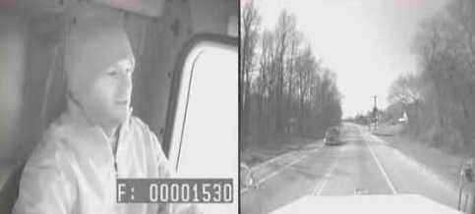
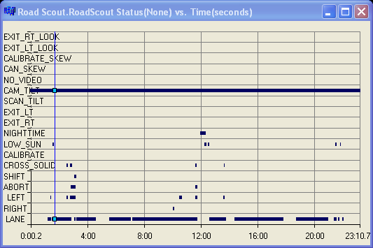

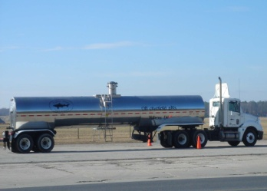
How? Behavior-Based Coaching (1 of 2)
  In-vehicle driver monitoring
  Video and data reviewed and analyzed
  Driver coaching and training on performance
  Driver returns to the field with new knowledge and/or techniques
1
2
3
4
Notes:
Narration: Behavior-based coaching is a four-step process. The first step involves in-vehicle driver monitoring. Typically these systems record the driver and forward view of the roadway. Additionally, some systems record vehicle state parameters such as braking, speed, etc. Event markers are triggered in the video and data recording when certain thresholds are met. For example, a hard braking event would trigger an event marker. The second step involves review and analysis of the video and data. Some systems are managed by a third party while others are solely managed by the carrier. The third step involves driver coaching and training which provides drivers with feedback about his/her performance recorded by the system. Safety managers and driver trainers can access the video and/or data for the necessary coaching and training. The fourth step is for the driver to return to the field with new knowledge and/or techniques that should improve his or her driving behavior. One thing to keep in mind are these systems are not solely for fatigue management but rather overall driving behavior. Distracted driving and fuel economy are just a couple of the other uses of this type of system.
________________
Key Points:
Behavior-based coaching is a four step process.
These systems are not solely for fatigue management but rather overall driver behavior (i.e., distracted driving, fuel economy, etc.).
Typically theses systems record the driver and the forward view of the roadway.
Certain vehicle state parameters (e.g., hard braking) trigger event markers in data recording.
Safety managers and driver trainers can access video and/or data for review.
Data from some systems is managed by a third party.

Slide 24
How? Behavior-Based Coaching (2 of 2)
Potential limitations to consider…
  Coaching takes place after risky driving behavior occurs
  Drivers may view required coaching as punishment
  Drivers must be willing to listen and learn
  Some systems may require monthly fee to access recorded video and/or data
Notes:
Narration: Some potential limitations to consider when using behavior-based coaching are that driver coaching and training takes place after risky driving behavior occurs, drivers may view required coaching as punishment, drivers must be willing to listen and learn, and some systems may require a monthly fee to access the recorded video and/or data.

Slide 25
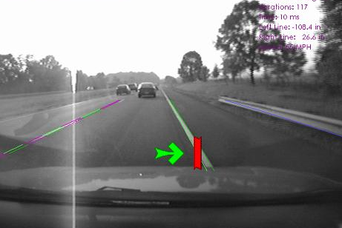
How? Vehicle Kinematics/Driver Input (1 of 2)
Lane tracking
  Computer-based algorithms using a camera, machine vision, and vehicle state to monitor lane position
  Warns driver when deviating from travel lane
  Typically referred to as Lane Departure Warning Systems (LDWS)
Steering input
  Sensor used to detect amount of steering input
  Warns driver when programmed limits are met
Notes:
Narration: Vehicle kinematics and driver input fatigue management technology concepts use lane tracking or steering input as the driver performance measure. Lane tracking uses computer-based algorithms in conjunction with a camera, machine vision, and vehicle state to monitor lane position. These systems warn the driver when he or she is deviating from the travel lane. Usually this warning is an auditory alert. Typically, systems using lane tracking are referred to as lane departure warning systems. Lane departure warning systems also tend to improve overall attention and performance even when the driver may not be fatigued. Fatigue management technology systems using steering input as the performance measure use a computer sensor to detect the actual amount of steering input and changes in steering behavior such as rapid lateral movements of the steering wheel (also known as drift and jerk steering). The driver is warned when programmed thresholds are met.
______________________
Key Points:
LDWS tend to improve drivers’ overall attention and performance even when not fatigued.
Steering sensors look for changes in steering behavior.
Rapid lateral movements of the wheel (i.e., drift and jerk steering).

Slide 26
How? Vehicle Kinematics/Driver Input (2 of 2)
Potential limitations to consider…
  Lane tracking
    Requires visible lane markings; night, adverse weather (e.g., snow), and faded lane markings may render the system ineffective at times
  Steering input
    Potential false alarms during driving conditions which require rapid and/or multiple steering inputs (e.g., off highway driving)
Notes:
Narration: There are a few potential limitations to consider with systems using vehicle kinematics or driver input. Lane tracking requires visible lane markings. Night, adverse weather such as snow, and faded lane marking may render the system ineffective at times. Potential false alarms may arise using steering input parameters during driving conditions which require rapid and/or multiple steering inputs such as off-highway driving or backing.

Slide 27
Single Vs. Multi-Channel FMT Systems
Single channel system relies on one predictor of fatigue
  Potential for intermittent data loss
Multi-channel system combines two or more predictors of fatigue
  Creates a more robust system
Few off-the-shelf multi-channel systems currently available
Notes:
Narration: Single and multi-channel systems are referring to driver level, in-vehicle fatigue management technologies. Single channel systems rely on one predictor of fatigue. An example of a single channel system would be a lane departure warning system. Single channel systems have the potential for intermittent data loss. For example, snow covered roads could render a lane departure warning system ineffective. Multi-channel systems combine two or more predictors of fatigue. An example of a multi-channel system would be combining a lane departure warning system with eye tracking using Perclos algorithms. This creates a more robust system for monitoring driver fatigue by compensating for the weaknesses of each predictor. There are few off-the-shelf multi-channel systems currently available; however, one could potentially create a multi-channel system with currently available single channel systems.
______________________
Key Points:
Single and multi-channel systems are referring to driver level, in-vehicle FMTs relating to driver input/vehicle kinematics and physiological concepts.
An example of a single channel system would be a lane tracking system.
Intermittent data could potentially come from snow covered roads or faded lane markings and could render a lane tracking system ineffective.
Multi-channel system example:
Lane tracking along with eye tracking using Perclos algorithms.
Compensates for the weaknesses of each predictor.
However, one could create a multi-channel system.

Slide 28
Making Sense of FMTs
Must be scientifically and operationally sound
Not all FMT concepts will work for every fleet
All FMT concepts contain limitations
Some FMT concepts overlap
  Occur both at the driver level and back-office level
  Occur both out-of-vehicle and in-vehicle
All systems are not created equal
Designed to aid the driver, not solve the problem
Notes:
Narration: Understanding and making sense of fatigue management technologies is an important part of the process when deciding on their use. Fatigue management technologies must be scientifically and operationally sound through third party scientific validation of concepts and of specific systems. Government and university research is a good starting point when looking for face, concurrent, and predictive validity of these concepts and systems. Not all fatigue management concepts will work for every fleet. These systems must prove to be reliable under the rigors of everyday driving in various conditions. A number of factors including fleet size and type of operation will help determine which fatigue management technology provides the greatest effectiveness for your carrier. One must accept that all fatigue management technologies contain limitations. Some of the concepts behind this technology overlap and occur both at the driver level and back-office level as well as out-of-vehicle and in-vehicle. Actigraphy is one such example of driver level and back-office level technology. All systems are not created equal. A good example of this inequality would be eye tracking. While Perclos has been found to be one of the most valid fatigue measures, how a vendor integrates a Perclos algorithm and the selected camera and infrared sensor can greatly vary the effectiveness and false alarms between systems using this technology. And finally, one must remember that fatigue management technologies are designed to aid the driver, not solve the problem.
__________________________
Key Points:
Third party scientific validation (face, concurrent, and predictive validity) of concepts and of specific systems (i.e., government and university research).
Must prove to be reliable under the rigors of everyday driving in various conditions.
A number of factors including fleet size and type of operation will help determine which FMT provides the greatest effectiveness for your carrier.
Actigraphy is an example of in-vehicle and out-of-vehicle technology.
Inequality of systems example:
While Perclos has been found to be one of the most valid fatigue measures, how a vendor integrates a Perclos algorithm and the selected camera and IR sensor can greatly vary the effectiveness and false alarms between different systems.

Slide 29

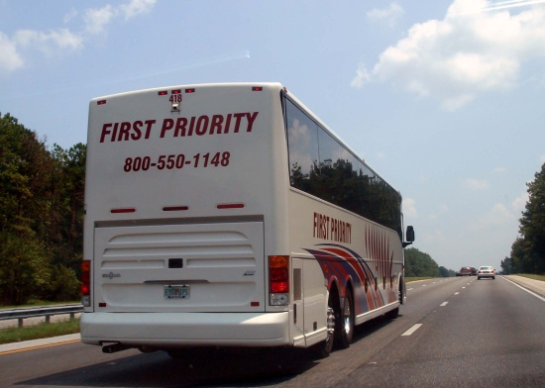
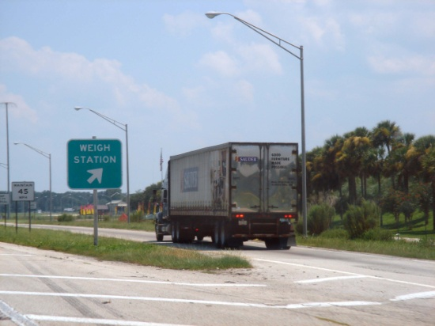
No Silver Bullet
FMTs are only one piece of the puzzle
Must be used within an overall FMP to shape positive safety culture
However, when used correctly, technology can reshape driving behavior leading to fewer driver errors
Notes:
Narration: There is no silver bullet when it comes to fatigue management technologies. These types of technologies are only one piece of the puzzle and they must be used within an overall fatigue management program to shape positive safety culture. However, when used correctly, these fatigue management technologies can reshape driving behavior leading to fewer driver errors and increased performance.

Slide 30
Lesson 2: Sample of Current Technologies
Notes:
Narration: During this lesson you will learn why technology is a snapshot in time, view cross-comparisons of a sample of fatigue management technologies including system type, vendor, performance measures, alert modality, and cost. Additionally, several technologies will be highlighted in further detail as examples of each of the fatigue management technology concepts.
_________________________
Key Points Overview:
Snapshot in time
Cross-comparison of a sample of FMTs including
System
Vendor
Performance measures
Alert modality
Cost
Several technologies will be highlighted in further detail as examples of each FMT concept

Slide 31

Snapshot In Time
Technology is on a continual path of evolution
FMTs available today may not be available in the future
Intended as a guide as undoubtedly future generations of FMTs will become available
Notes:
Narration: Current fatigue management technologies are really just a snapshot in time. Technology is on a continual path of evolution and fatigue management technologies available today may not be available in the future. This training module is intended as a guide as undoubtedly future generations of these technologies will become available. Many factors influence the comings and goings of fatigue management technologies including but not limited to effectiveness, cost, vendors going out of business or selling a system to another vendor, or new concepts replacing old concepts. As new fatigue management technologies become available, this lesson could be updated to reflect the most promising of these technologies. The framework of the lesson should remain the same; however, expect the content to change based on new fatigue management technologies.
________________________________________
Key Points:
As new FMTs become available, this lesson could be updated to reflect the most promising technologies
The framework of the lesson will remain the same; however, expect content to change based on new FMTs
Many factors influence the coming and going of FMTs
Effectiveness
Cost
Vendors going out of business or selling system to another vendor
New technology concepts replace old technology concepts

Slide 32
Inform Not Endorse
This lesson is not meant as a recommendation or endorsement of any FMT
Rather, this lesson is meant to provide a broad overview of FMTs on the market purported to address fatigued driving
  Must be aware that not all vendor claims and/or system specifications have been validated
Providing the information in this module gives fleet managers and decision makers with a broad overview of specific systems
Costs for specific FMTs vary widely and may be impractical for your fleet
Information meant to inform, not endorse
Notes:
Narration: This lesson is not meant as a recommendation or endorsement of any fatigue management technology. Rather, this lesson is meant to provide a broad overview of the technologies on the market purported to address fatigued driving. The main point is educating carriers on what they may encounter when it comes to fatigue management technologies; not endorsing, recommending, or advocating for any vendor or specific fatigue management technology. Likewise, this is not disproving or criticizing any fatigue management technologies, included or omitted from this training module. One must be aware that not all vendor claims and/or system specifications have been validated. Providing the information in this module gives fleet managers and decision makers a broad overview of specific systems. Costs for specific fatigue management technologies vary widely and may be impractical for your fleet. Carrier decision makers should seek out further information and system specifics; this training module is just the beginning step in the process. Again, information meant to inform, not endorse.
______________________
Key Points:
The main point of this training module is educating carriers on what they may encounter when it comes to FMTs.
Not endorsing, recommending, or advocating for any FMT
Likewise, this is not disproving or criticizing any FMTs, included or omitted from this training module .
Carrier decision makers should seek out further information and system specifics; this training module is just the beginning step in the process.

Slide 33
Physiological FMTs - Actigraphy
System | Vendor | User Interface | Driver Feedback | Cost (US$) per System
Motionlogger® | Ambulatory Monitoring, Inc. | Wrist worn watch | Visual Auditory | $1,295.00^
Readiband | Fatigue Science | Wrist worn watch | None | $300.00^
Actiwatch Spectrum | Phillips | Wrist worn watch | None | Contact for pricing^
SOMNOwatch | SOMNO Medics | Wrist worn watch | None | Contact for pricing^
- Available FMT pricing as of May 2012
^ Additional software and cable/docking station needed for one time cost.
Notes:
Narration: This lesson will begin with fatigue management technologies using physiological concepts. The table shown displays some of the actigraphy devices currently available. Note that some systems do require additional equipment at a one-time cost. Clicking on the vendor name will direct you to their website for further details and contact information.
______________________
Click on the vendor name to be directed to their website for further details and contact information.

Slide 34
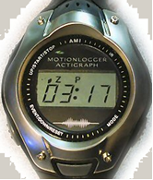
Ambulatory Monitoring
Motionlogger® Watch (1 of 2)
Actigraphy metrics
  Uses four sleep pattern algorithms and circadian rhythm analysis
  Assesses sleep, rest, and activity patterns
  Off-wrist detection and temperature recorded
  Provides visual and auditory alerts about driver state based on inferred need for sleep
  Contains reaction time test
Water resistant sports-style watch with time, day, date, stop watch, alarm, and backlight
Notes:
Narration: This actigraphy device uses four sleep pattern algorithms and circadian rhythm analysis to assess the sleep, rest, and activity patterns of the wearer. It includes off-wrist detection and ambient temperature recording features. Additionally, it provides visual and auditory alerts about driver’s state based on inferred need for sleep and a reaction time test. This device is contained in a water resistant sports-style watch with time, day, date, stop watch, alarm, and backlight.

Slide 35
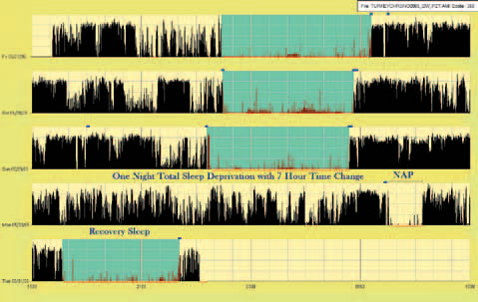
Ambulatory Monitoring
Motionlogger® Watch (2 of 2)
Data can be downloaded for analysis and graphing to be reviewed with driver
Data is compatible with Fatigue Avoidance Scheduling Tool (FAST)
Watches can be swapped between drivers every 30 days to reduce cost
One time fee for analysis software and cable
  $500.00
Notes:
Narration: Further, the data from this actigraphy device can be downloaded for analysis and graphing that potentially could be reviewed with the driver and used to help with scheduling. The data derived from this device are compatible with the Fatigue Avoidance Scheduling Tool. Watches can be swapped between drivers every 30 days to reduce cost and establish a baseline for all drivers. There is a one time $500 fee for the analysis software and cable to connect the device to a computer.

Slide 36
Physiological FMTs – Eye Measures
System | Vendor | Performance Metrics | User Interface | Driver Feedback | Cost (US$) per System
EA401 Driver Fatigue Monitor | EyeAlert™ | Perclos | Dash mounted camera | Auditory | $485.00
Alertness Monitoring System | Optalert | Amplitude velocity ratio | Driver worn glasses and dash mounted LCD | Visual | $4,000.00
Sleepiness Detection System | BioCogniSafe | Facial parameters recognition | Dash mounted camera and LCD | Visual | Contact for pricing
Drowsiness State Sensor | seeingmachines | Perclos | Dash mounted camera | Auditory | Contact for pricing
- Available FMT pricing as of May 2012
Notes:
Narration: This table displays some of the currently available fatigue management technology systems that use eye measures to estimate fatigue. Clicking on the vendor name will direct you to their website for further details and contact information. The next few slides will highlight two of these technologies.

Slide 37
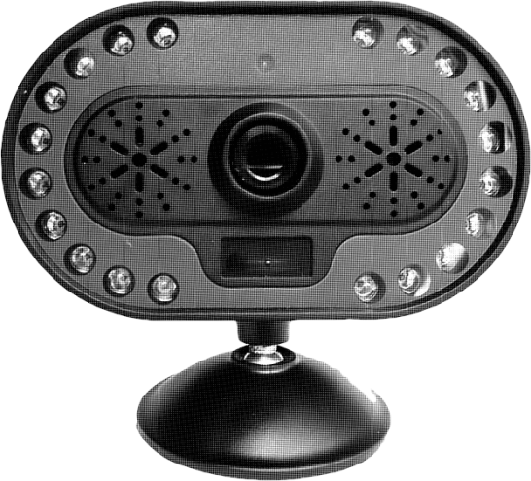
EyeAlert™ EA401
Driver Fatigue Monitor
Eye measures
  Uses proprietary Perclos based algorithms for analysis and alerts
Dash mounted camera with IR LEDs
  Four sensitivity level settings for different driving environments
  Auditory alert to warn of impending fatigue
  Not affected by weather or off-highway use
Data can be downloaded for review
Portable and plugs into 12 volt power port
Notes:
Narration: This system uses proprietary Perclos based algorithms for analysis and alerts. This is a dash mounted camera with infrared light emitting diodes that has four sensitivity level settings for different driving environments. It provides an auditory alert to warn the driver of impending fatigue and is not affected by weather or off-highway use. The data can be downloaded for review if desired. This system is portable and plugs into a 12 volt power port.

Slide 38
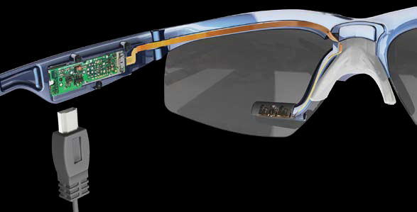
Optalert Alertness Monitoring System (1 of 2)
Eye measures
  Measures eyelid velocity 500 times per second
Two part system
  Driver worn glasses
  Dashboard indicator
Back office can view all drivers in real time
Notes:
Narration: This system uses the amplitude velocity ratio concept to measure the eyelid velocity 500 times per second. It consists of two parts: driver worn glasses and a dashboard indicator. Through vehicle telemetry, the back-office has the ability to view estimated driver fatigue levels in real time.

Slide 39
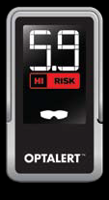
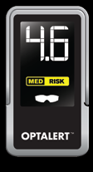
Optalert Alertness Monitoring System (2 of 2)
Driver worn glasses
  Five lens configurations for different lighting conditions
  Prescription lens compatible
  Transmits data to LCD
Dashboard display
  Provides drowsiness score
  Shows current risk level
  Easy to read LCD
Notes:
Narration: The driver worn glasses are available in five lens configurations for different lighting conditions and are compatible with prescription lens. A small infrared transmitter and receiver are contained within the ear stems of the glasses and transmit data to the dashboard mounted liquid crystal display screen. The dashboard display provides the driver with a drowsiness score and current color-coded risk level.

Slide 40
Vehicle Kinematics/Driver Input FMTs
System | Vendor | Performance Metrics | User Interface | Driver Feedback | Cost (US$) per System
Autovue LDWS | Bendix Commercial Vehicle Systems | Lane tracking | Windshield mounted camera and under dash computer | Auditory | $830.00^
Mobileye C2-270 | Mobileye | Lane tracking | Dash mounted display | Auditory | Contact for pricing
SafeTrak 3 w/TIM | Takata | Lane tracking | Windshield mounted camera and dash mounted driver interface | Auditory | Contact for pricing
Advisory System for Tired Drivers (ASTID) | Fatigue Management International | Steering input, sleep pattern, type of driving | LCD & LEDs | Visual Auditory | $1000.00
- Available FMT pricing as of May 2012
^ Additional software required for data recording
Notes:
Narration: This table displays some of the currently available fatigue management technology systems that use vehicle kinematics or driver input to estimate fatigue. Clicking on the vendor name will direct you to their website for further details and contact information. The next few slides will highlight two of these technologies.
_____________________
Click on the vendor name to be directed to their website for further details and contact information.

Slide 41
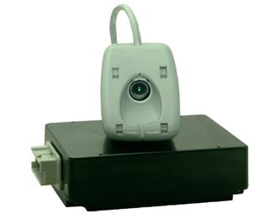
Bendix Commercial Vehicle Systems, LLC Autovue LDWS
Vehicle kinematics/driver input metrics
  Detects lane departures using proprietary algorithms and software using machine vision
  Detects both solid and dashed lines
  Provides auditory rumble strip sound warning
  Signal usage disengages alert
  Automatically disabled below 37mph (60kph)
Windshield mounted camera
Computer with proprietary software mounted under dash
SafetyDirect software must be purchased to add data recording capability
Notes:
Narration: This system is a lane departure warning system using proprietary algorithms and software with machine vision to detect lane departures. It is capable of detecting both solid and dashed painted lane marking lines on the roadway and provides an auditory rumble strip sound to alert the driver when deviating from the travel lane. Turn signal usage and speed below 37mph or 60kph disengages the system to reduce the chance of false alarms. The camera is mounted on the windshield while the computer is mounted under the dash. Additional SafetyDirect software must be purchased to add data recording capability, if desired. This system is available as OEM or aftermarket installation with a 10- to 12-year life expectancy.
_____________________________
Additional information:
Available as OEM or aftermarket installation
10-12 year life expectancy

Slide 42
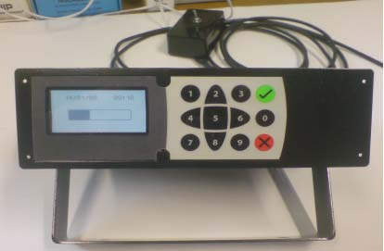
Fatigue Management International
Advisory System for Tired Drivers (1 of 2)
Multi-channel system metrics
  Gyroscopic steering sensor to detect variations in steering input
  Shift duration, driving conditions, circadian rhythm analysis, and prior sleep pattern
Data can be downloaded or transmitted wirelessly in real time to back office
Notes:
Narration: This is a multi-channel system combining driver input measures with physiological measures. A gyroscopic steering sensor is used to detect variations in steering input by the driver while shift duration, driving conditions, circadian rhythm analysis, and prior sleep pattern make up the physiological measures. Prior sleep is subjectively entered by the driver prior to beginning his or her shift. Good, bad, or poor are levels able to be selected by the driver. Data recorded by the system can be downloaded or transmitted wirelessly in real time to the back office through vehicle telemetry.
____________________
Additional information:
Prior sleep pattern is subjectively entered prior to driving: “good”, “poor”, or “bad” night’s sleep is entered by the driver.

Slide 43
Fatigue Management International
Advisory System for Tired Drivers (2 of 2)
Dash mounted in-cab display
  Proprietary algorithm combines all metrics and produces tiredness score each minute
  Tiredness score visually displayed for driver
  Auditory warning when threshold score is met
Available as original equipment manufacturer (OEM) and aftermarket application
Notes:
Narration: The in-cab display is dash mounted and uses a proprietary algorithm that combines all performance metrics and produces a tiredness score each minute. This tiredness score is visually displayed for the driver and an auditory warning is provided when the pre-set threshold score is met. This system is available as an OEM or aftermarket application.

Slide 44
Behavior-Based Coaching FMTs
System | Vendor | Performance Metrics | User Interface/Location | Cost (US$) per System
Drivecam | Drivecam | Forward and in-cab video, vehicle state | Windshield mounted | $495.00^
DV101E | Rosco Vision | Forward and in-cab video, GPS, and speed | Windshield mounted | $831.88*
Smartdrive | Smartdrive Systems | Forward and in-cab video | Windshield mounted | Contact for pricing^
- Available FMT pricing as of May 2012
* Base price
^ Additional monthly fee required
Notes:
Narration: This table displays some of the currently available behavior-based coaching systems. Clicking on the vendor name will direct you to their website for further details and contact information. The next slide will highlight one of these technologies.

Slide 45
DriveCam
Behavior-based safety
  Windshield mounted forward looking and in-cab camera provide continuous video
  Vehicle state (i.e., speed, braking, etc.) are used in tandem with video to record triggered events
Driver auditory alert
Recorded data transmitted to third party for analysis and review
User accesses data through third party
Notes:
Narration: This behavior-based safety system uses a windshield mounted camera and an in-cab camera to provide continuous video. Vehicle state parameters are used in tandem with the video to record triggered events. Proprietary computer algorithms define the parameters that determine triggered events as well as define when an auditory warning is used to alert the driver of a potential crash. Data recorded by this system is transmitted to a third party for analysis and review. Carriers then may access the data through a secure server for review and coaching the driver. There is a monthly fee associated with this system.
______________________
Additional information:
Computer algorithms define parameters that capture triggered events (e.g., hard braking maneuver)
Computer algorithms also define auditory alert for driver based on machine vision combined with vehicle state (e.g., potential rear-end collision)

Slide 46
Psychomotor FMTs
System | Vendor | Performance Metrics | User Interface | Cost (US$) per System
Critical Tracking Task | Systems Technology, Inc. | Hand-eye coordination | Back office | $4,500.00
PVT-192 | Ambulatory Monitoring, Inc. | Reaction time | Back office | $2,500.00
Antisleep Pilot | Antisleep Pilot | Reaction time and 26 risk factors | Dash mounted | $179.00
Reactive Fatigue Warning System | C-track | Reaction time | Dash mounted | Contact for pricing
- Available FMT pricing as of May 2012
Notes:
Narration: This table displays some of the currently available fatigue management technology systems that use psychomotor skills to estimate fatigue. Clicking on the vendor name will direct you to their website for further details and contact information. The next slide will highlight one of these technologies.
_____________
Click on the vendor name to be directed to their website for further details and contact information.

Slide 47
Systems Technology, Inc.
Critical Tracking Task
Psychomotor skill metrics
  PC-based fitness-for-duty test
  Tests hand-eye coordination and general cognitive function
Equivalent to balancing broomstick in palm of hand
Works on any Windows based computer
Objective and non-invasive approach
Typically takes one minute to administer
Notes:
Narration: This is a PC-based fitness for-duty test. It tests hand-eye coordination and general cognitive function. The test is equivalent to balancing a broomstick in the palm of your hand. It can be administered on any Windows-based computer using a joystick or video game steering wheel and is an objective and non-invasive approach. Test time typically takes one minute.
______________________
Additional information:
Uses joystick or video game steering wheel

Slide 48
Scheduling & Trip Planning FMTs
System | Vendor | Application | User Interface | Cost (US$) per System
Disaptcher ID™ | Faid Safe | Fleets | Back-office PC-based | Contact for pricing
Circadian Alertness Simulator | Circadian® | Fleets | Back office PC-based | Contact for pricing
Fatigue Avoidance Scheduling Tool (FAST) | Fatigue Science | Fleets | Back office PC-based | $7,500.00*
Intelli Route TND760 | Rand McNally | Fleets | Dash mounted touch screen LCD | $800.00
Intelli Route TND510 | Rand McNally | Owner-Operators | Dash mounted touch screen LCD | $400.00
- Available FMT pricing as of May 2012
* Cost is for a single two year license for one computer.
Notes:
Narration: This table displays some of the currently available scheduling and trip planning software that may be used as fatigue management tools. Clicking on the vendor name will direct you to their website for further details and contact information. The next slide will highlight one of these technologies.
_________________
Click on the vendor name to be directed to their website for further details and contact information.

Slide 49
Fatigue Science
Fatigue Avoidance Scheduling Tool
Non-driver based system
  Proprietary software that uses circadian rhythm analysis and fleet scheduling to model fatigue risk
FAST software
  Compatible with Windows-based PCs
  Graphs fatigue risk
  Provides assessment of why schedules create potential fatigue risk
Compatible with Motionlogger® watch data
License renewal at same two year rate
Notes:
Narration: This is a non-driver based system using proprietary software with circadian rhythm analysis and fleet scheduling to model potential fatigue risk. The FAST software is compatible with Windows-based PCs, will graph potential fatigue risk, and provides an assessment of why schedules create such a potential fatigue risk. This software is compatible with the data from the Motionlogger® actigraphy watch. Additionally, the software license must be renewed every two years at the same rate.

Slide 50
Lesson 3: Deployment Considerations and Operational Guidelines
Notes:
Narration: During this lesson the following deployment considerations will be highlighted:
Cost;
Return on investment;
Fleet size and locations;
Potential legal implications; and
Driver behavior.
The following operational guidelines will also be covered:
Policies for driver compliance;
Driver performance measures;
Operational protocols;
Training; and
Driver acceptance.
These guidelines are meant as a starting point to help shape the decision process, planning, and implementation of fatigue management technologies.
_________________________
Key Points Overview:
Deployment considerations to be highlighted:
FMT cost
Fleet size and locations
Potential legal implications
Behavioral Adaptation
Operational guidelines topics
Policies for driver compliance
Driver performance measures
Operational protocols
FMT training
Driver acceptance
These topics are meant as a starting point to help shape the decision process, planning, and implementation of FMTs

Slide 51

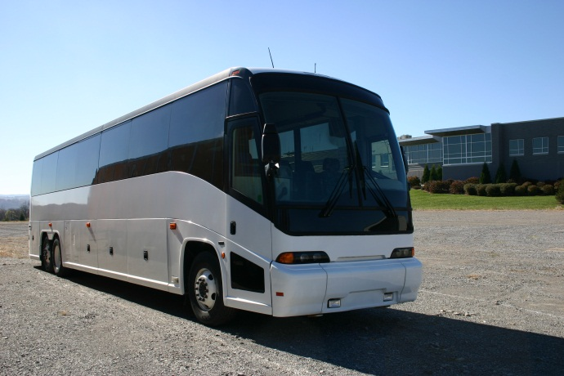
FMT Cost
Often a limiting factor when determining use
  Initial purchase price
  Return on investment
  Fleet size and locations
  Training
Financing vs. outright purchase
Must look at the big picture
Notes:
Narration: Cost of fatigue management technologies is often a limiting factor when determining use within a fleet. Some factors to consider are the initial purchase (which often decreases as the number of systems purchased increases), the return on investment, the size of the fleet and locations of terminals, and the training required for the drivers, shop technicians, and any other personnel that will be involved with the fatigue management technologies. Another aspect of the cost is whether the system chosen will be financed or purchased outright. You must look at the big picture and take all aspects into consideration. Not only direct benefits, but indirect benefits must be factored in as well.
_________________________
Key Points:
Initial purchase price often decreases as the number of systems purchased increases.
Should also compare the costs of different FMTs
Training includes drivers, back-office personnel that may be involved with the FMT, and shop personnel required for installation and maintenance.
The big picture should take all aspects into consideration.
Not only direct benefits but indirect benefits.

Slide 52
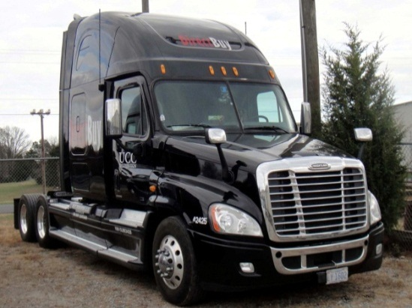
Return On Investment
May be viewed as the most important aspect for FMT fleet integration
  Impact of avoiding just one fatigue-related crash per year
Indirect cost benefits should also be considered
  CSA score, cost of driver replacement, environmental clean up, etc.
Other factors that play a role on ROI
  Fleet size
  Self insured vs. non-self insured
  Type of operation
Notes:
Narration: The return on investment may be viewed as the most important aspect for fatigue management technology integration by a carrier. Fleet managers and decision makers should gauge how important it is to employ such systems if they successfully deter driver fatigue and avoid at least one fatigue-related crash per year. Indirect cost benefits should also be considered including but not limited to the carriers CSA score, cost of driver replacement, and environmental clean up to name a few. Other factors that also play a role on a carrier’s return on investment are the fleet size, whether the carrier is self-insured or not, and the type of operation.

Slide 53
Return On Investment:
Lane Departure Warning System Example
LDWS have shown direct cost benefits (ATRI, 2009)
  Benefits over five year period outweigh costs of purchasing, installation, and maintenance
  Payback periods (time to recoup initial cost) vary depending on annual vehicle miles traveled (VMT)
  For every $1 spent on LDWS, more than $1 in benefits were returned across all groups
Average VMT | Low End | High End
80,000 | $1.54 | $3.03
120,000 | $2.31 | $4.54
160,000 | $3.09 | $6.06
Anticipated benefits per dollar spent on LDWS (no financing). Adapted from Houser, A. et al. (2009).
Notes:
Narration: In previous research, the American Transportation Research Institute has shown lane departure warning systems have direct cost benefits. The benefits over a five-year period outweigh the costs of purchasing, installation, and maintenance combined. Payback periods, which are the time to recoup initial cost, vary depending on annual vehicle miles traveled. For one dollar spent on lane departure warning systems, more than one dollar in benefits was returned across all groups. The table displays the low and high end for three groups based on annual vehicle miles traveled. This research could potentially be used as a template for other fatigue management technologies.
____________________
Key Points:
This potentially could be used as a template for other FMTs
The full report can be found here:
http://www.fmcsa.dot.gov/facts-research/research-technology/report/09-022-RP-Lane-Departure.pdf

Slide 54
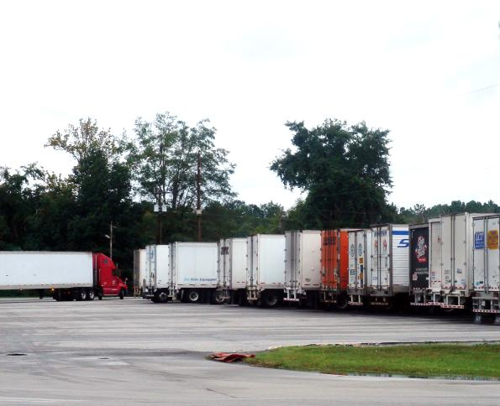
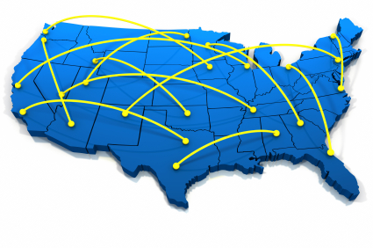
Fleet Size & Locations
Number of power units
  Affects initial purchase costs
  Vehicle out-of-service time
  Drivers
Terminal/shop locations
  Single versus multiple installation locations
  Affects cost & personnel resources
Notes:
Narration: Fleet size and location should also be considered. The number of power units will affect initial purchase cost. The larger the fleet, the more the initial cost will be for the purchase of fatigue management technologies. Potentially, these systems can be purchased in phases to help reduce the financial burden. Vehicle out-of-service time is another factor. Trucks off the road do not make money for the company. A plan should be devised for scheduling to minimize power unit down time. The larger the fleet, the more drivers that will need to be trained. This should be another consideration. Fleets with more than one terminal will require more resources and must have the relevant equipment at each location. This also increases the number of back-office personnel and shop technicians that will need to be trained on FMT installation and operational procedures.
_____________________
Key Points:
The larger the fleet, the more the initial cost will be for the purchase of FMTs.
Potentially can purchase FMTs in phases to help reduce burden or finance the purchase.
Trucks off the road do not make money for the company.
A plan should be devised for scheduling to minimize down time.
The larger the fleet, the more drivers that will need to be trained.
Fleets with more than one terminal will require more resources.
Relevant equipment for FMTs at each location.
Increases number of back-office personnel and shop technicians that will need to be trained on FMT installation and operational procedures.
Typically no more than one to two hours for FMT installation.
Shop space can become an important factor.
Must schedule accordingly to accommodate routine maintenance.
Possibility of FMT installation during routine maintenance.
Proper installation includes mounting and wiring, calibration and alignment if necessary, and routine inspection.
Must ensure systems are fully functional when deployed.
Can assign technicians responsible for FMTs or train all technicians.

Slide 55
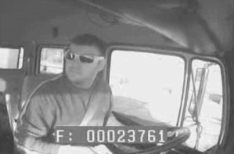
Potential Legal Implications
Consider company policies and procedures
  Driver video
  Driver and vehicle data
  Use of video and data
Awareness of security concerns
  Storage of collected video and data
  Who has access to video and data
Notes:
Narration: Other considerations with fatigue management technologies are potential legal implications. Company policies and procedures must consider driver video, driver and vehicle data, and how this video and data will be used. Ensure the driver knows he/she is being recorded on video and reiterate this is not a punishment and all drivers are being recorded. Clear and concise policy on what the video and data can be used for is a must. Be aware that this technology may be brought up in court cases by other parties. There should also be an awareness of security concerns regarding the storage of collected video and data and who has access to this video and data. Video and data should be secured on a password protected computer or server in the back-office. Access to video and data should be limited to a few select personnel (i.e., safety manager, transportation director, driver trainer).
_____________
Key Points:
Ensure driver knows he is being recorded on video.
Reiterate this is not punishment.
All drivers are being recorded.
Clear and concise what the video and data will be used for:
Driver training and coaching
To help reduce possible safety incidents
Daily review, weekly review, only for safety incidents, etc.
Be aware that FMTs may be brought up in court cases by other parties
Video and data should be secured on a password protected computer or server in the back-office.
Access to video and data should be limited to a few select personnel (i.e., safety manager, transportation director, driver trainer).

Slide 56
Driver Behavior:
Possible Influences
Potential for creating positive OR negative effects
  Both cannot occur concurrently
The positive
  Promotes greater self awareness
  Reshapes driving habits and routines
  Encourages safety conscious work environment
The negative
  Reliance on FMT to prevent crashes and near crashes
  Complacency in driving
Reinforces the need for an overall positive safety culture to eliminate the negative side of the coin
Notes:
Narration: On the minds of many safety managers are the possible influences on driver behavior these systems cause. There is a potential for creating positive or negative effects; however, both cannot take place concurrently. This is commonly referred to as behavioral adaptation. The positive, which is called response generalization, can potentially promote greater self-awareness, reshape driving habits and routines, and encourages a safety conscious work environment. A positive (response generalization) example would be the increase in safety belt use as drivers become more safety conscience by using fatigue management technologies. The negative, which is called risk compensation, can potentially influence a driver to rely on the system to prevent crashes and near crashes and bring complacency in driving habits. A negative (risk compensation) example would be research that has shown antilock braking systems have increased risk taking by some drivers (for example, driving faster, following lead vehicle more closely). While no definitive research has been conducted on possible driver influences of fatigue management technologies, recent research has shown this is a big concern of safety managers.
_________________________
Key Points:
Commonly referred to as behavioral adaptation.
Positive is called response generalization; Negative is called risk compensation.
While no definitive research has been conducted on possible driver influences of FMTs, recent research has shown this is a concern of safety managers.
Positive (response generalization) example: Increase in safety belt use when “buckle-up” placards are placed around the terminal.
Negative (risk compensation) example: Some research has shown that antilock braking systems have increased risk taking by some drivers (i.e., driving faster, following lead vehicle more closely) (Sagberg, F., Fosser, S., and Saetermo, I. 1997)

Slide 57

Policies for Driver Compliance
Constructed by the fleet FMP Steering Committee
Establish before FMT installation
Clear and concise
  What are the compliance standards?
  Penalties for non-compliance
Thoroughly discussed with all drivers
  Safety meetings
  Posted in terminals/dispatch office
Maintain the standard
  Do not selectively enforce
  Drivers must be held accountable for their actions
Notes:
Narration: Policies for driver compliance should be constructed by the fleet fatigue management program steering committee and established before integration and installation of any fatigue management technologies. The policies that are constructed should be clear and concise and spell out the standards and penalties for non-compliance. These policies should be thoroughly discussed with all drivers during safety meetings and posted in the terminals and dispatch offices. Management should always be available to answer questions and periodic review of the policies with drivers should be required. Maintaining the standard is important for driver compliance. Do not selectively enforce the policy. Drivers must be held accountable for their actions.
_____________________________
Key Points:
Policies should always be readily available for the driver to review.
Required periodic review of policies with the drivers by management.
Management should always be available to answer questions.

Slide 58
Driver Performance Measures
FMTs that record data or transmit in real time
Goes hand-in-hand with driver compliance
  Performance measures must be reasonable
  Driver has sufficient knowledge and training to meet the minimum performance level
Back-office
  Analysis and review in a timely manner
  Driver training/coaching to meet minimum performance level
Notes:
Narration: Fatigue management technologies that record data or transmit in real time should have driver performance measures established. Driver performance measures go hand-in-hand with driver compliance. Performance measures must be reasonable and drivers must have sufficient knowledge and training to meet the minimum performance level. If the driver does not have sufficient training and/or knowledge to meet expectations, then fatigue management technologies will not be accepted by the drivers. The key is to be reasonable and not to expect perfection. The back-office should perform any analyses and review them in a timely manner and provide driver training and coaching to drivers so they can meet the minimum performance level. Company training policies must reflect performance expectations.
____________________________________
Key Points:
The key is to be reasonable and not to expect perfection.
If driver does not have sufficient training and/or knowledge to meet expectations then FMT will not be accepted by the driver.
Company training policies must reflect performance expectations.

Slide 59

Driver Acceptance
Critical ingredient to successful FMT implementation
Set the example from the top down
Provide validity, facts, and benefits
Emphasize driver assistance and not continual supervision
  Not “big brother”
Remain open minded to questions, apprehension, and suggestions
Ensure drivers do not view FMTs as punishment
Notes:
Narration: Driver acceptance is a critical ingredient to successful fatigue management technology implementation. Management needs to set the example from the top down. Drivers should be provided with the validity, facts, and benefits of these systems and ensure drivers to do not view this as punishment. Emphasize these systems are for driver assistance and not continual supervision. Drivers should not have the fear of “big brother.” Management must remain open-minded to questions, apprehension, and suggestions. When evaluating a fatigue management technology for implementation behind the scenes, the Federal Motor Carrier Safety Administration has developed a methodology to assess if drivers will accept a specific system across five concepts: ease of use, ease of learning, perceived value, driver behavior, and advocacy.
_____________________________
Key Points:
The aspects in this list should be conducted on a daily basis with interaction with the drivers
Behind the scenes when evaluating a FMT for implementation the Federal Motor Carrier Safety Administration has developed a methodology to assess if drivers will accept a specific system across five concepts:
Ease of use
Ease of learning
Perceived value
Driver behavior
Advocacy
The full report can be found here
http://www.fmcsa.dot.gov/facts-research/research-technology/report/Emerging_Detection_Measures_508.pdf

Slide 60

FMT Training
Shop technicians (in-vehicle FMTs)
  Proper installation techniques
  Routine FMT inspection
Drivers
  How the FMT functions
  What to expect
  Type(s) of alerts if applicable
  What to do when alerted
  Observing the FMT in action
  Avoiding negative driver responses
    Keep in mind that without driver acceptance, not likely to be successful
Notes:
Narration: Training must also be considered when implementing any fatigue management technology. Shop technicians must be trained on proper installation techniques of in-vehicle technologies and must perform routine maintenance inspections. Likely the most important aspect of training are the drivers. Drivers must know how the fatigue management technology functions, what to expect from this system, type of alerts if applicable, and what to do when alerted. Additionally, drivers should observe the technology in action before using on their own. The training must be presented in a positive way to avoid negative driver responses. Keep in mind that without driver acceptance, it is not likely to be successful.

Slide 61
Operational Protocols
Predefined written procedures
  Creates standardized format and method
  Ensures end result can be replicated regardless of personnel
  Detail oriented and easily accessible
Potential protocol needs
  FMT installation and maintenance
  Driver training
  Driver non-compliance
  Data analysis, review, and storage
✓
Protocol 1
Protocol 2
Protocol 3
✓
Notes:
Narration: Operational protocols are predefined written procedures that create a standardized format and method and ensure the end result can be replicated regardless of personnel. Protocols should be detail-oriented and easily accessible. Potential protocol needs may include fatigue management technology installation and maintenance, driver training, driver non-compliance, and data analysis, review, and storage. This is not an all inclusive list, but rather a starting point and will vary from fleet to fleet.
_______________________________
Key Points:
This list of potential protocols is not all inclusive; rather, a starting point and will vary from fleet to fleet.

Slide 62
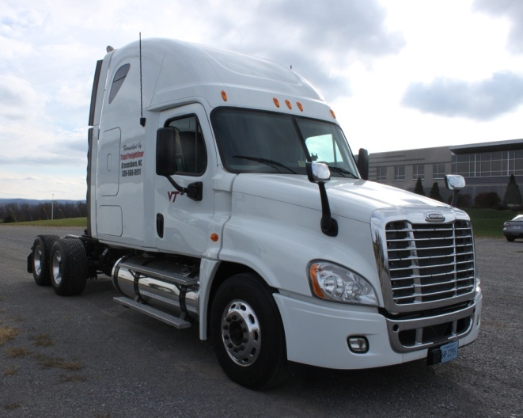
Fundamental Technology Issues
Single channel FMTs are most common
Potentially no independent review and validation of system
Driver acceptance
Technology never stops evolving
  What is here today, may be gone tomorrow; however new technologies may be available
Notes:
Narration: There are some fundamental issues when dealing with fatigue management technologies. Single channel systems are the most common. Some systems available potentially have no independent review and validation. Again, driver acceptance is an issue. If drivers do not accept fatigue management technologies, it is unlikely to produce beneficial results. And one must always remember that technology never stops evolving. What is here today, may be gone tomorrow. However, new technologies will likely become available.
_____________________________
Key points:
Single channel FMTs use single predictor of drowsiness.
FMTs should improve driver performance and safety; therefore providing a good ROI.
If drivers do not accept FMTs, it is unlikely to produce beneficial results.

Slide 63
FMT Evaluation
Research the new technology
  University and government studies
  Current testing
Contact vendor for specifications and cost
  FMT classification and concept
  Technical documentation
  Expected service life
Create benchmarks for comparison to current FMTs of same concept
Determine projected cost-benefit of new FMT
Notes:
Narration: When assessing whether to implement a fatigue management technology several initial steps should be taken. Researching this technology through any university and government studies and any on-going testing should be the first step. Contacting the vendor for specifications and cost will help determine the classification of this technology and the concepts that drive it. A thorough review of the technical documentation of the system as well as determining the expected service life should be conducted. Creating benchmarks for comparison to current fatigue management technologies of the same concept will allow an initial glance at system performance. Also, determining the projected cost-benefit of the new fatigue management technology will provide management with some initial numbers on whether to move forward with this technology. Prior research has shown many of the requirements needed to be successful include: validity, reliability, is it practical, and durability.
_________________________
Key Points:
Prior research has shown many of the requirements needed for FMTs to be successful.
A few examples are….validity, reliability, practical, durable, etc.
Refer to the reference for further discussion and information on a useful framework for FMTs.
Dinges, D.F., “The Promise and Challenges of Technologies for Monitoring Operator Vigilance,” Proceedings of the Managing Fatigue in Transportation Conference, Tampa, FL, 1997, pp. 77-84.

Slide 64
Conclusion: Review & Summary
Notes:
Narration: We’re almost done. Here is a brief review of what we have discussed.

Slide 65
FMT Definition & Classifications
Systems designed to recognize and mitigate driver fatigue with the goal of warning drivers and reducing fatigue related driving errors
FMTs
Driver
Level
Vehicle Kinematics
Physiological
&
Psychomotor
Back-office
Level
Non-driver
Measures
In-vehicle
Out-of-vehicle
Classifications and relationships of FMTs
Notes:
Narration: Here are some of the definitions and classifications we have covered. Take a moment to review them.
Fatigue management technologies are systems designed to recognize and mitigate driver fatigue with the goal of warning drivers and reducing fatigue-related driving errors. The diagram displayed shows the classifications and how they are related to one another. It is important to understand that some overlap can occur. Physiological and psychomotor concepts can occur both at the driver level and back-office level as well as in-vehicle and out-of-vehicle.
____________________
Key Points:
Overlap of classification occurs with some FMTs
Physiological and psychomotor concepts
Can occur both at the driver level and back-office level
Can occur both in-vehicle and out-of-vehicle

Slide 66
FMT Concepts
Concepts forming the foundation of FMTs
  Physiological Measures (eye measures & actigraphy)
  Psychomotor Skills (cognitive function)
  Behavioral-based (coaching)
  Vehicle Kinematics/Driver Input (lane and steering)
  Single vs. Multi-Channel systems
Notes:
Narration: Here are the concepts you have learned.
The concepts that form the foundation of fatigue management technologies are physiological measures, psychomotor skills, behavior-based, vehicle kinematics, and driver input. Additionally, systems based on a single predictor of fatigue are single channel systems while systems based on two or more predictors of fatigue are multi-channel systems. Multi-channel systems create a more robust fatigue management technology.

Slide 67
FMTs: Part of the Team
A fatigue management program is a team concept
FMTs are only one part of the equation
FMTs
FMP
Education
Sleep
Notes:
Narration: Fatigue management technologies are only one part of the team. An overall fatigue management program is a team concept and these technologies are only one part of that equation.

Slide 68
Best Practices
Must be integrated into overall FMP
Take full advantage of the FMT capabilities
Develop well-defined protocols
Explain the role of FMTs with drivers
Create meaningful driver expectations
Present consistent and detailed feedback for drivers
Maintain a positive atmosphere
Reinforce that safety is everyone’s responsibility
Notes:
Narration: When implementing any type of fatigue management technology some best practices should be followed.
The technology must be integrated into an overall fatigue management program;
It must take full advantage of the system capabilities; and
Develop well-defined protocols;
The role of fatigue management technologies must be explained to the drivers;
Meaningful driver expectations must be created;
Consistent and detailed feedback must be presented for drivers;
A positive atmosphere must be maintained; and
The idea that safety is everyone’s responsibility must be reinforced.
This concludes the North American Fatigue Management Program Training Module 10: Fatigue Monitoring and Management Technologies. You may return at any time to review this module as needed.

