Slide 1
Module 4:
Family Education
Notes:
Complete Narration: “This is North American Fatigue Management Program Module 4, Family Education. Fatigue management is essential for truck and bus drivers, both for their safety and for their long-term health. Drivers’ families play a critical role.”
_______
Notes for Trainers: Module 4, Family Education, is almost entirely a subset of Module 3, Driver Education. Topics related to driver home life are repeated in this module, although sometimes in simplified terms. Topics related to fatigue management on the road are generally not included in this module.

Slide 2

Importance of Home & Family
Special place, special people, & special time together
Home should be the foundation for driver health, wellness, & fitness
Notes:
Complete Narration: “Home is a special place, with special people, and special time together. Home should be the foundation for driver health, wellness, and fitness. Providing support to help the driver in your family stay healthy and safer on the road should be a top priority.
_______
Notes for Trainers: The last bullet captures a basic assumption of this module and its instructional approach. That is, driver health and family health go together.

Slide 3


Family Education Learning Goals
What are your goals for this training?
Understand commercial driver fatigue, alertness, sleep, & wellness
Apply this knowledge to support better sleep and wellness at home
Value sleep and wellness as major factors in performance, safety, and happiness not only for your driver, but for your whole family
Notes:
Complete Narration: “As the driver’s family, you play a critical role. By the end of this module, we want you to understand commercial driver fatigue, alertness, sleep, and wellness. You should also see how you can apply this knowledge to support better sleep and wellness at home, not just for the driver in your family, but for the whole family. And we hope that you will come to value sleep and wellness as major factors in performance, safety, and happiness.”
_______
Notes for Trainers: General Module 4 learning goals are stated here. Note that the three goals correspond to knowledge, skill, and attitudes.

Slide 4

Module 4 Overview
Introduction
Fatigue Basics
Alertness, Sleep, Wellness, & Performance
Fatigue Characteristics
Fatigue-Related Crashes
Physiology of Sleep & Alertness
What is Sleep?
Factors Affecting Alertness & Fatigue
Sleep Disorders
Health & Alertness
Health & Wellness
Drugs & Medications
Improving Sleep & Alertness
Conclusion
Notes:
Complete Narration: “Here are the topics we will be covering. Take a moment to review them. After this introduction, we’ll be covering fatigue basics, the physiology of sleep and alertness, and health and alertness. If you like, at the conclusion you can take a short self-test on what you have learned.”
_______
Notes for Trainers: In addition to the Introduction and Conclusion, there are three main sections, each covering three topics. All of these topics are also covered in Module 3, although some individual slides relating to home and family life are new in this module. As a trainer, you should be thoroughly familiar with the Module 3 material as well as the material in Module 4.

Slide 5
Lesson 1: Fatigue Basics
Notes:
Complete Narration: “Fatigue Basics includes Alertness, Sleep, Wellness, and Performance. It will also cover the characteristics of fatigue and how fatigue can cause crashes.”
Notes for Trainers:
Sections in this lesson:
Alertness, Sleep, Wellness, & Performance
Fatigue Characteristics
Fatigue-Related Crashes

Slide 6
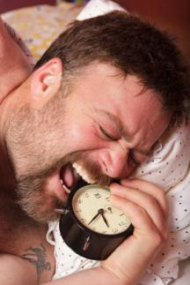
Importance of Sleep, Alertness, & Wellness to Health
Sleep is a biological need
Poor sleep contributes to:
  Cardiac conditions
  Diabetes
  Obesity
  Psychological disorders
  Other medical conditions
Good sleep promotes wellness, high performance, and happiness
Notes:
Complete Narration: “Like food and water, sleep is a biological need, Have you ever felt crabby when you were hungry? Getting poor or inadequate sleep can have the same effect, often straining relationships within your family. Poor sleep contributes to cardiac conditions, diabetes, obesity, psychological disorders, and other medical conditions. Good sleep promotes wellness, high performance, and personal happiness.”
________________
Notes for trainers: Research continues to tell us more about the importance of sleep and the negative health consequences of poor sleep. Sleep is almost as important as a good diet and exercise for one’s overall health. Poor sleep degrades health, while good sleep improves it.

Slide 7


Importance of Sleep, Alertness, & Wellness to Safety
Falling asleep-at-the-wheel is a top cause of crash deaths for commercial drivers
Medical crises are another major cause of road deaths
A serious at-fault crash can end a driver’s career
It can put a company out of business
Notes:
Complete Narration: “Sleep, alertness, and wellness are also important to safety. Asleep-at-the-wheel crashes are a top cause of death for commercial drivers. Medical crises, which can be associated with poor sleep, are another major cause of road deaths. A serious at-fault crash can end a driver’s career, and it can put a company out of business.”
Notes for trainers: Statement about asleep-at-the-wheel crashes is based on a 1990 study by the National Transportation Safety Board (NTSB, 1990). More detail will be provided later in this module. The NAFMP Implementation Guide contains a list of references cited in the modules.

Slide 8

Alertness, Wellness, & Sleep
What is alertness?
Alert = awake + attentive
What is wellness?
Wellness = physical, mental, emotional, & behavioral health and well-being
Good sleep is essential for both alertness and wellness
Notes:
Complete Narration: “What can be done to prevent these serious crashes? One way is to be more alert and well. What is alertness? Being “alert” means you are awake and attentive. What is wellness? Wellness is physical, mental, emotional, and behavioral health and well-being. Good sleep is essential for both alertness and wellness.”
_______
Notes for Trainers: Presented here are definitions of the terms “alertness” and “wellness,” and their connections to good sleep. Alertness relates more to safety, while wellness relates more to health.

Slide 9
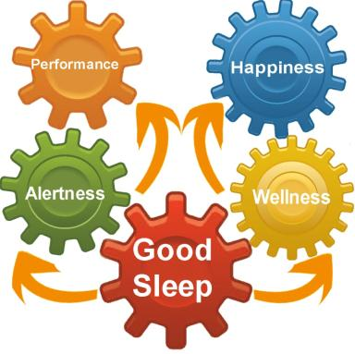
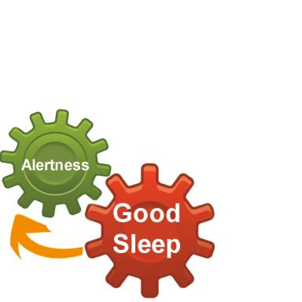
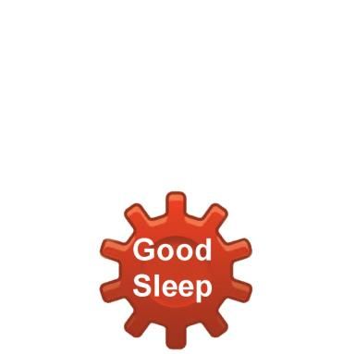
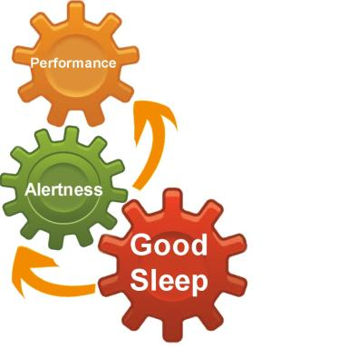
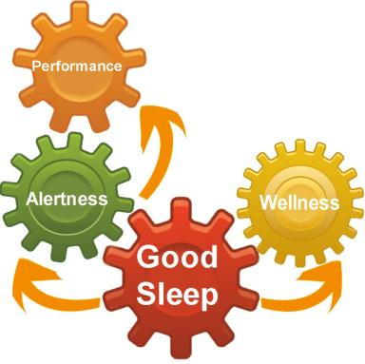
Good Sleep: A Key to
Performance & Happiness
Notes:
Complete Narration:
“Yes, it all starts with good sleep.
[add arrow & Alertness] Good sleep is essential for alertness . .
[add arrow & Performance] and alertness makes good performance possible.
[add arrow & Wellness] Good sleep is also essential for wellness . . .
[add arrow & Happiness] and wellness is a big ingredient in personal happiness. That makes sleep one of the most important things in your life.”
_______
Additional comment: Research has proven the links between good sleep and alertness, performance, and wellness. The link to happiness is more subjective, but most people would agree that happiness is in part the result of having good health and being able to perform well.

Slide 10


Home & Family
Home should be the foundation for driver health, wellness, & fitness to drive
Driver health & wellness goes hand-in-hand with family health & wellness
Yet there are many different home & family demands
Notes:
Complete Narration: “…And good sleep starts at home. Home is the foundation for driver health, wellness, and fitness to drive. Driver health and wellness goes hand-in-hand with family health and wellness. Yet there are many different home and family demands that can affect health and wellness.”
Notes for trainers: Health-related behaviors, good and bad, tend to run in families. A goal of the module is for couples and families to value health and to strive for better health-related behaviors.

Slide 11

Fatigue involves . . .
Decreased alertness
Decreased attention to the environment
Reduced performance
Reduced motivation
Irritability
Impaired judgment
Feelings of drowsiness
Notes:
Complete Narration: “Fatigue involves decreased alertness, decreased attention to the environment, reduced performance, reduced motivation, irritability, impaired judgment, and, usually, feelings of drowsiness. Driving fatigue is not the same as muscular fatigue. Physical fatigue from manual work or exercise usually does not affect driving.”
___________
Notes for trainers: It is difficult to define fatigue exactly because of its many different sources and symptoms. The predominant features, however, are decreased alertness and feelings of drowsiness, and the resulting risk of falling asleep. The term “vigilance” is sometimes used to refer to attention to the environment.

Slide 12
Acute vs. Chronic Fatigue
Acute (short-term) fatigue:
  Experienced every day
  Reduced or eliminated by a night’s sleep or nap
  Caffeine and rest (without sleep) reduce mild fatigue
Chronic (long-term) fatigue:
  Afflicts many drivers and other busy people
  Due to inadequate sleep over a longer period
  Called sleep deprivation
  Need a few nights of long, sound sleep
Notes:
Complete Narration: “There are two general categories of fatigue. Acute or short-term fatigue is what we experience every day. It is reduced or eliminated by a night’s sleep or a nap. Caffeine and rest (without sleep) reduce mild fatigue. Chronic, or long-term, fatigue afflicts many drivers and other busy people. It is due to inadequate sleep over a longer period, and is also called sleep deprivation. To recover, you need a few nights of long, sound sleep and, often, changes to your lifestyle.”
________
Notes for Trainers: Fatigue management involves dealing with acute fatigue, which is short-term, everyday fatigue, and reducing chronic or long-term fatigue. If drivers and families manage their everyday acute fatigue, they won’t have chronic fatigue.
Additional information: In regard to chronic fatigue, the emphasis here is on the primary role played by sleep loss. Other psychological stressors may contribute, including a driver’s lifestyle, work conditions, interpersonal relations, and financial stability. A person with serious chronic fatigue may need to resolve or reduce other sources of stress in addition to obtaining recovery sleep.

Slide 13

Signs & Symptoms (1 of 2)
Drowsiness
Loss of alertness & attention
Wandering thoughts
Poor response, slow reactions
Distorted judgment
Notes:
Complete Narration: “Whether fatigue is acute or chronic, there are certain signs and symptoms. They include drowsiness, loss of alertness and attention, wandering thoughts, poor response with slow reactions, and distorted judgment.”
________
Notes for Trainers: This slide and the next one provide a more detailed list of specific signs and symptoms of fatigue. Anyone trying to assess their own level of fatigue should focus on specific signs and symptoms like these, not just on how tired they feel. Subjective self-assessments are not very accurate.

Slide 14
Signs & Symptoms (2 of 2)
Loss of motivation
Depression
Impaired memory
Microsleeps
Little effect on purely
physical tasks!
Notes:
Complete Narration: “Additional signs and symptoms of fatigue include loss of motivation, depression, impaired memory, and microsleeps. Microsleeps are short losses of consciousness. You “nod off” for a few seconds. Microsleeps become longer, more frequent, and more dangerous with greater fatigue. . . . Note, however, that fatigue has little effect on purely physical tasks such as walking or lifting.”
________
Notes for Trainers: Additional fatigue signs and symptoms. In classroom instruction, ask participants if and when they have experienced microsleeps. Driving? Reading? On the computer? Also, give one or more examples of physical tasks relatively unaffected by loss of sleep. Here’s one example: Ultramarathoners run 100 miles or more over 20-40 hours. Although they are physically exhausted, they rarely fall asleep. Most people could not drive or operate other machines for that amount of time without nodding off.
Additional information: The word “depression” is used here in a general sense; i.e., the condition of being sad or melancholy. It does not refer to clinical psychiatric depression, which is a separate and serious medical condition. Sleep loss is known to exacerbate clinical depression, however.

Slide 15
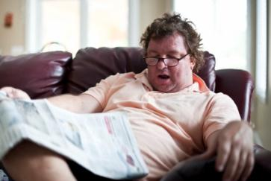
Health Effects of Sleep Deprivation (1 of 2)
Increased blood pressure
Increased risk of heart disease
Gastrointestinal problems
Sick days
Increased calorie consumption
Weight gain
Notes:
Complete Narration: “The health effects of sleep deprivation are less immediate but equally frightening. They include increased blood pressure, increased risk of heart disease, gastrointestinal problems, sick days, increased calorie consumption, and weight gain.”
______________
Notes for trainers: The case for the medical importance of sleep has been building over recent decades of research. The increasing incidence of obesity in the U.S., Canada, and other western countries is in part due to insufficient sleep relating to long work hours and increasing time spent commuting. Principal source: Saltzman and Belzer, 2007.

Slide 16

Health Effects of Sleep Deprivation (2 of 2)
Increased diabetes risk
Reduced immune system functioning
More likely to smoke & use alcohol
Disrupted relationships
Psychiatric problems
Decreased quality of life
Notes:
Complete Narration: “Additional health effects of sleep deprivation include increased diabetes risk, reduced immune system functioning, greater likelihood of smoking and alcohol use, disrupted relationships, psychiatric problems, and decreased quality of life.”
_________________
Notes for trainers: Almost everyone knows that lack of sleep can make people irritable and “out of sorts,” but they probably don’t realize that it contributes to more serious medical and psychological problems such as those listed. Principal source: Saltzman and Belzer, 2007.

Slide 17
Are you chronically sleep-deprived?
Fall asleep in 5 minutes or less?
Nap almost anywhere, any time?
Feel sleepy when bored?
Fall asleep while watching TV or in movies?
Fall asleep while stopped for traffic lights?
Notes:
Complete Narration: “Are you chronically sleep-deprived? Is a loved one? Do you or your loved one fall asleep in 5 minutes or less? Nap almost anywhere, anytime? Feel sleepy when bored? Fall asleep while watching TV or movies? Fall asleep while stopped for traffic lights?”
________
Notes for Trainers: These five questions are poised to stimulate self-evaluation by drivers and families. There is no specific scoring to the questions, but more than one or two “yes” answers suggests chronic sleep loss. It might be fun to ask couples to answer for both themselves and their spouses, and then compare their answers. Drivers’ self-perceptions may differ from those of their spouses.

Slide 18
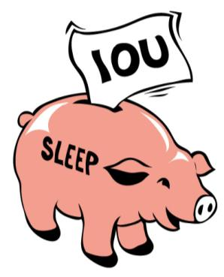
Sleep Debts
If you answered “yes” to most of the previous questions, you are probably sleep deprived
In other words, you have a sleep debt
Like financial debt, you need to start paying it off
Only one way to pay your debt → SLEEP!
Notes:
Complete Narration: “If you answered “yes” to most of the previous questions, you are probably sleep deprived. In other words, you have a sleep debt. Like a financial debt, you need to start paying it off. There’s only one way to pay your debt: Sleep!”
________
Notes for Trainers: The “debt” analogy is a motivator because everyone understands what it means to be in debt. The terms “sleep deprivation” and “sleep debt” have slightly different connotations, but are basically the same thing. If you have one, you have the other.

Slide 19

Recovery from Sleep Deprivation
Begins following one night of good sleep
May not be complete until after several nights
Solution:
  Don’t get sleep deprived to begin with.
  Whenever possible, sleep until you wake up.
  Get more than one good night’s sleep on weekends.
To some extent, extra sleep can be “banked”
Notes:
Complete Narration: “Here is some good news: Recovery from sleep deprivation begins following one night of good sleep. But it may not be complete until after several nights. The real solution involves lifestyle changes. Don’t get sleep deprived to begin with. Whenever possible, sleep until you wake up – don’t set an alarm clock. And get more than one good night’s sleep on weekends. There’s more good news: To some extent, extra sleep can be “banked.” Getting more sleep on a weekend will help, to some extent, all week. That’s true of drivers and other family members as well.”
________
Notes for Trainers: Ideally, people would never develop sleep debts and thus would never need to recover. But few people achieve that. Recovery sleep pays off the sleep debt, although usually not in one night. As a discussion, ask drivers and their families about their weekend routines and how much recovery sleep they get. Are they able to get all the recovery sleep they need?
Additional information: Item on “banking” of extra sleep based on a sleep deprivation study conducted by the Walter Reed Army Institute of Research (Balkin, 2011). Subjects spending 10 hours a night in bed for a week before the sleep deprivation period were more alert than those who just followed their normal routine (7-8 hours in bed) prior to the sleep deprivation period.

Slide 20

Fatigue-Related Crashes
Usually single-vehicle road departures
Driver alone
Often on monotonous roads
Most in early morning, especially 2:00 am to 7:00 am
Usually serious crashes
Notes:
Complete Narration: “What would happen if you closed your eyes for ten seconds while driving? You’d probably drift out of the lane and hit something. That’s the typical fatigue-related crash. They are usually single-vehicle road departures, although a driver could drift to the left and have a head-on crash. Drivers falling asleep are usually alone, and often driving on monotonous roads. Most of these crashes occur in the early morning, especially between 2 and 7 am. Fatigue-related crashes are usually serious. They are at least twice as likely as other crashes to result in injuries or death.”
_____________-
Notes for trainers: Most fatigue-related crashes have most of these characteristics, but not all do. Fatigue-related crashes can occur under almost any circumstance. Plus, it is difficult to determine and document the role of fatigue in many crashes. Knipling (2009) discusses fatigue-related crashes in more detail.

Slide 21


Principal Cause: Insufficient Sleep
Australian study found that truck drivers with <6 hours sleep were:
  3 times more likely to have a hazardous incident
  2.5 times more likely to nod off
Notes:
Complete Narration: “Fatigue-related crashes are usually associated with insufficient sleep prior to the crash. A study in Australia found that truck drivers who had had less than 6 hours sleep were 3 times more likely to have a hazardous incident, and 2.5 times more likely to nod off. HOS regulations give drivers the opportunity to receive adequate rest/sleep”
___________
Notes for trainers: This data is based on a case-control study where drivers involved in fatigue-related crashes were compared with those who did not. This allows the statistical association of risk factors like lack of sleep with crash outcomes like nodding off. Australian study: Arnold and Hartley, 1998.

Slide 22

Fatal-to-the-Driver Truck Crashes
National Transportation Safety Board (NTSB) study of 182 fatal-to-the-driver large truck crashes
Most were single-vehicle road departures
Investigations revealed fatigue to be a principal cause in 31%
Fatigue was the biggest cause
Cardiac and other medical crises are also major causes of such crashes
In 2010, more than 500 U.S. commercial drivers died in crashes
Notes:
Complete Narration: “The National Transportation Safety Board studied 182 fatal-to-the-driver large truck crashes. Most were single-vehicle road departures. Their in-depth investigations revealed fatigue to be a principal cause in 31% of these crashes . . . the biggest single cause. Crash studies also suggest that cardiac and other medical crises are major causes of such crashes. In 2010, more than 500 truck and bus drivers died in crashes.
________
Notes for Trainers: Source: NTSB, 1990. 56 of 182 crashes (31%) had fatigue as a principal factor. The NTSB large truck fatal-to-the-driver statistic is the only crash percentage cited in the module. That’s because of its relevance to drivers and to family concerns for their safety. Other statistics are provided in Module 3.

Slide 23
Lesson 2: Physiology of
Sleep & Alertness
Notes:
Complete Narration: “Let’s talk about the physiology of sleep and alertness. What is sleep? What factors affect alertness and fatigue? What are sleep disorders?”
_______
Notes for Trainers: The Module 4 information on these topics is also similar to that presented in Module 3.
Sections in this lesson:
What is Sleep?
Factors Affecting Alertness & Fatigue
Sleep Disorders

Slide 24

Key Features of Sleep
Sleep is necessary for performance and wellness, but no one knows exactly how or why!
Brain cells grow and connections are made during sleep
Sleep ≠ rest
Sleep is complex. The brain is not simply resting
Notes:
Complete Narration: “What are the key features of sleep? Sleep is necessary for performance and wellness, but no one knows exactly how or why! It is known, however, that brain cells grow and connections are made during sleep. Sleep does not equal rest; there’s a big difference between them. We know this from research showing that sleep is complex. The brain is not simply resting.”
________
Notes for Trainers: The topic begins with some key, basic features of sleep. A key point is that sleep and physical rest are very different. Sleep is studied in sleep labs where people are monitored for EEG (“brain waves”), heart rate, and breathing.

Slide 25
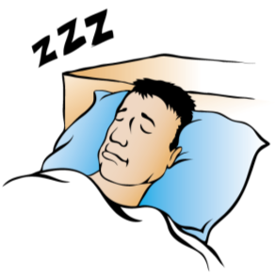
Two Types of Sleep
“Regular” (Non-REM)
  Most of the night
  Brain activity reduced but varied
  4 repeating stages of different depths.
Rapid Eye Movement (REM)
  Brain active
  Eye movements
  Dreams
  Loss of muscle tone (~paralysis)
Notes:
Complete Narration: “There are actually two different types of sleep. ‘Regular’ or non-REM sleep takes up most of the night. Brain activity is reduced, but varied. There are four repeating stages of different depths, ranging from light to deep. The second type is called Rapid Eye Movement or ‘REM’ sleep. During REM sleep the brain is very active, almost like being awake. Your eyes move, much as they would in actual vision. REM sleep is when you dream. You lose your muscle tone during dreams, much like paralysis. REM sleep is like a car in neutral but with its engine racing!”
______________
Notes for trainers: The structure of sleep is quite complex. Within non-REM sleep (known technically as “Slow Wave Sleep”), each of the four stages has distinct electroencephalograph (EEG) patterns. In addition, heart rate and other physiological measures vary systematically during sleep. Loss of muscle tone in REM sleep occurs in major muscle groups, but not in the muscles that move the eyes.

Slide 26
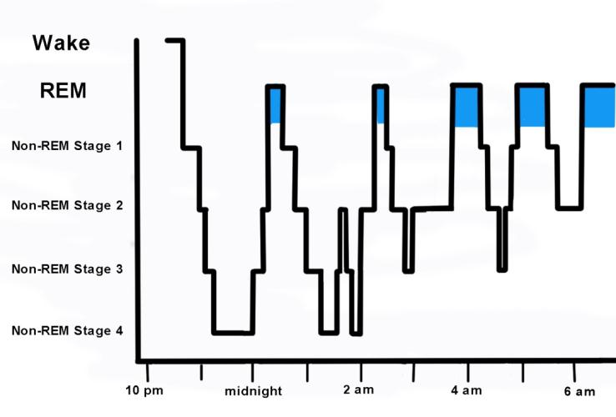
Sleep States & Stages
REM = Rapid Eye Movement
Notes:
Complete Narration: “This graph shows nightly sleep stages for a healthy young adult. On the left, the vertical axis shows six brain conditions: wakefulness, REM sleep, and Non-REM stages 1, 2, 3, and 4. This person sleeps from about 11 pm to 7 am. The night starts with a long period of non-REM sleep, with a progression of stages, down and back up. This is repeated through the night, but with the addition of REM periods – the colored areas on the graph. As the night progresses, REM periods become more frequent and longer. You see also that, toward morning, the non-REM periods are not as deep as they were earlier. You might wake up during these times.”
________
Notes for Trainers: Sleep states and stages across the night. “Regular” (non-REM) sleep is known technically as Slow Wave Sleep. Ask participants if they think their own sleep matches this pattern. Why do most people wake up more in the second half of the night than in the first? The reason is that non-REM periods later in the night become lighter and so it is easier for people to wake up.

Slide 27


Causes of Bad Sleep
Busy lives
Long commutes
Stress relating to work or home, sometimes involving strained relationships
Incorrect sleep-related behaviors
Poor sleep environment
Effects of aging
Medical conditions
Notes:
Complete Narration: “There are many causes of bad sleep. We lead busy lives, and many working people have long commutes. Many of us experience stress related to work or home, sometimes involving strained relationships. Many people have incorrect sleep-related behaviors. You may be trying to sleep in a poor sleep environment. The effects of aging include more fragmented sleep, and medical conditions often affect sleep as well.”
_______
Notes for Trainers: The causes of bad sleep is a good topic for discussion. Ask participants if they have trouble sleeping and, if so, which of these causes seems to apply. Note that the term “sleep hygiene” is not used in this module. Introduce the term to your group if you feel it would be helpful.

Slide 28

Factors Affecting Sleep Quality
Quantity affects quality
Other factors affecting quality:
  Bed comfort
  Darkness of room
  Time-of-day
  Noise
  Temperature (cool is best)
  Anything else that might awaken you
Notes:
Complete Narration: “What determines sleep quality? First, quantity affects quality. The more sleep you get, the more likely you will go through all the sleep stages. Other factors affecting sleep quality include bed comfort, darkness of the room, time-of-day, noise, temperature (cool is best), and anything else that might awaken you.
________
Notes for Trainers: Factors affecting sleep quality. Ask participants whether they have made any physical changes to their homes to improve their sleep. What works? Additional question to probe learning: We stated four or five characteristics of REM sleep. Can students state three of them? Answer: Rapid eye movements, brain is active, dreams, loss of muscle tone. Also, REM sleep periods become longer and more frequent as the night progresses.

Slide 29

Amount of Sleep
Last main sleep period
(e.g., last night)
Previous sleep periods
(e.g., the nights before; even previous weekend)
Naps
Notes:
Complete Narration: “Sleep is the primary factor affecting alertness and fatigue. Most important is the amount of sleep in your last main sleep period. For most people, that means last night. Previous sleep periods, including the nights before and even the previous weekend, also affect current alertness. And naps provide an alertness boost.”
____________
Notes for trainers: Subsequent slides will provide more detail on the first and last bullets. In regard to previous sleep periods, recall what we learned earlier about sleep debts and recovery.

Slide 30
Progressive Effects of Different Amounts of Sleep on Performance
Notes:
Complete Narration: “The amount of sleep you get affects your performance, and these effects can get progressively worse over time. This graph shows the results of a sleep deprivation study involving volunteer truck and bus drivers. They were paid to live in a laboratory for nearly two weeks and take a series of tests. There were four groups. The top, blue line shows those who spent 9 hours in bed each night. As you can see, their performance remained steady and high across the 8 days. The second, pink line shows those permitted 7 hours in bed. They did pretty well, though you see a small decline over the 8 days. The next line shows those given 5 hours in bed; their performance showed a steady decline. Now look at the last, red line showing performance deterioration among drivers given only 3 hours in bed each night. Their performance declined dramatically. All the differences were progressive; that is, they got bigger and more pronounced with each passing day.”
_______
Notes for Trainers: Not everyone is used to interpreting graphs, so this slide may be difficult for some participants. Make sure they understand its key implications regarding the progressive effects of repeated sleep loss. As sleep deprivation (whether mild or severe) continues, sleep debts continue to grow and performance becomes worse. Source: Balkin et al., 2000. Performance measure was the Psychomotor Vigilance Test (PVT), a measure of visual attention which is frequently used in studies of alertness and fatigue. This work was conducted at the Walter Reed Army Institute of Research with commercial drivers as subjects.

Slide 31

Naps
Powerful!
Even a short, 20-minute nap can greatly improve alertness and performance for hours afterwards
NASA study of airline pilots: Planned naps reduced subsequent dozing by 50% and errors by 34%
One caution: Long naps (> 1 hour) can keep you awake the next night
Notes:
Complete Narration: “Ever hear the phrase “power nap.” Well, naps really are powerful! Even a short, 20-minute nap can greatly improve alertness and performance for hours afterwards. NASA conducted a study of transcontinental airline pilots. Taking planned naps reduced their later dozing by 50% and their landing errors by 34%. One caution about naps. Long naps of an hour or more can keep you awake the next night.”
_______
Notes for Trainers: Napping is an interesting topic for discussion. Many people love naps, but not everyone! Ask participants how often they nap and how beneficial they are. You might also ask people when they like to nap. Afternoon naps are most common and beneficial. Cited NASA study: Rosekind et al., 1994. In this study, pilots were permitted to nap for up to 45 minutes; the average was 26 minutes. The 45-minute maximum was to ensure that pilots did not fall into deeper stages of sleep (i.e., Non-REM Stages 3 & 4), which would have increased the incidence and duration of sleep inertia upon awakening.

Slide 32

Time-of-Day
Circadian rhythms:
Physiological
  Body temperature
  Hormones
Controlled by the brain
Seen in virtually all animals
Resistant to change (such as during shift changes)
Affected by light & dark
Notes:
Complete Narration: “In general, during which times of the day do you get sleepy? During which times are you most alert? Almost everyone has large, predictable variations in their daily alertness levels due to circadian rhythms. Circadian rhythms are physical, mental and behavioral changes that follow a 24-hour cycle. For example, there are daily fluctuations in body temperature and in hormones. Circadian rhythms are controlled by the brain and are seen in virtually all animals, not just humans. They are resistant to change, which is why work shift changes can be tough. Circadian rhythms are influenced by light and dark. Bright lights help to keep you awake while darkness promotes sleep.”
_______
Notes for Trainers: Time-of-day as a factor in alertness is another interesting topic. In the U.S./Canada Driver Fatigue and Alertness Study (Wylie et al., 1996), time-of-day was the factor showing the greatest effect on observed drowsiness. You might ask if participants find themselves sleepy at the same times every day. When is that? Most people follow the circadian pattern shown in the next slide.

Slide 33
Daily Circadian Rhythm
Notes:
Complete Narration: “This graph gives you a picture of your daily 24-hour circadian cycle. You can see that your levels of alertness are lowest in the wee hours of the morning – around 4 or 5 am. Your alertness then rises rapidly toward a late morning peak. Alertness dips in mid-afternoon, but then rises again in the evening. By 10 pm or so, it begins to fall. With some exceptions, almost everyone follows this general pattern.”
_______
Notes for Trainers: A schematic of daily alertness and arousal due to circadian rhythms. Different physiological and performance measures follow slightly different patterns, but this shows the general pattern. Ask if anyone can describe their own predictable daily alertness changes in relation to the graph. Source: Knipling, 2009.

Slide 34

Circadian Effects on
Our Lives & Work
Peak performance times include:
  Mornings after 8 am
  Evenings
Valleys include:
  Deep valley: early mornings before sunrise.
  Shallow dip: early- to mid-afternoon
Circadian disruption (like shift changes) can be difficult
Because of circadian rhythms and alerting effects of light, sleeping during daytime is difficult
Notes:
Complete Narration: “Circadian rhythms are tenacious, and they affect us every day. Peak performance times include mornings after 8 am, and evenings. A deep valley occurs in the early morning before sunrise. A shallow dip is seen in the early- to mid-afternoon. Circadian disruption (like shift changes) can be difficult. A person might be drowsy, irritable, and generally out-of-sorts. Finally, because of circadian rhythms and the alerting effects of light, sleeping during the daytime is difficult for most people. Later we will suggest ways to make daytime sleep better.”
_______
Notes for Trainers: This slide repeats some information from the schematic and discusses sleep problems that might be related to circadian rhythms. Do participants or their spouses need to sleep during the day? Is it difficult? A good source on circadian rhythms and sleep in general is Moore-Ede (1993).

Slide 35
Time Awake
16+ hours awake → sleepy
Study compared alertness effects of long times awake to those of alcohol (BAC):
  17+ hours awake ≈ 0.05% BAC
  24+ hours awake ≈ 0.1% BAC
16 HOURS
AWAKE
Notes:
Complete Narration: “Disregarding naps, about how many hours are you awake each day before you start getting sleepy? For most people, it is about 16 hours. A sleep deprivation study compared alertness effects of long hours awake to those of drinking alcohol. Being awake for more than 17 hours was like a .05% Blood Alcohol Content on some tests. Being awake for 24 or more hours was like a .1% BAC, above the legal limit.”
__________
Notes for Trainers: Time awake is another topic where people can compare their own lives to “the textbook.” Do participants find that they do indeed get sleepy each day after about 16 hours awake? Study: Dawson and Reid, 1997.

Slide 36


Task-Related & Environmental Factors
Time driving
Traffic
Boring roads
Weather conditions
Environmental stress
  Heat
  Noise
  Vibration
Notes:
Complete Narration: “Your body’s internal factors are most important for alertness, but task and environmental factors have effects as well. These include time driving, traffic, boring roads, weather, and environmental stress, such as heat, noise, and vibration.”
_______________
Notes for trainers: Module 3 discusses task-related factors in more detail, including “time-on-task” (time driving or time working).

Slide 37
Individual Differences in Susceptibility
U.S./Canada Driver Fatigue & Alertness Study
Notes:
Complete Narration: “There are also large individual differences in susceptibility to fatigue. A joint U.S./Canadian study provided evidence. On the left, drivers are divided into the 14% with the most drowsy episodes, and the remaining 86%. On the right, you can see that the high-risk 14% drivers accounted for more than half (54%) of all the drowsy periods.”
_______
Notes for Trainers: This graph dramatically illustrates the magnitude of individual differences in fatigue susceptibility, although not everyone may understand it. Try to walk them through it until it is clear. A problem for high-risk drivers is that they may not realize that they are high-risk. Some of the reasons for their lack of insight were discussed in Module 3. Source: Wylie et al., 1996.

Slide 38

Why are some people more susceptible to fatigue?
Differences in sleep-related behaviors
Differences in health & fitness
Medications
Natural variations
Sleep disorders
Notes:
Complete Narration: “What causes individual differences in fatigue susceptibility? First, there are differences in sleep-related behaviors, the good and bad habits we all have. Next are differences in general health and fitness. Many medications have fatigue side effects. There are also natural variations among people in sleep patterns and susceptibility to fatigue. Finally, sleep disorders affect many people. That will be our next topic.
________________
Notes for trainers: Our emphasis in this module is on sleep-related behaviors and sleep disorders as causes of individual differences in susceptibility. But there are natural variations in sleep patterns and fatigue susceptibility among healthy people as well.

Slide 39
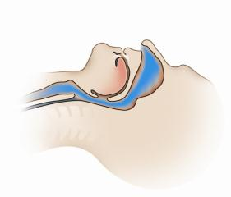
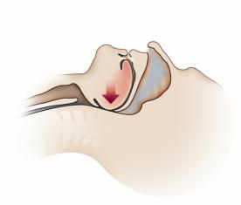
What is Obstructive Sleep Apnea (OSA)?
Apnea = stoppage of breathing lasting 10+ seconds
OSA = breathing stops repeatedly during sleep due to closures of the upper airway
Apnea rate per hour:
  <5 = normal
  >5 = OSA
OSA severity (mild, moderate, severe) based on rate
Some people with severe OSA can have 100 per hour!
© ResMed 2011 Used with Permission
Notes:
Complete Narration: “One of the most important sleep disorders is Obstructive Sleep Apnea (or OSA). An apnea is a stoppage of breathing lasting 10 seconds or more. In OSA, it happens because the upper airway in the back of throat closes. Apnea rates of less than 5 per hour are considered normal, but 5 or more indicates OSA. OSA severity is determined by a sleep test. Some people with severe OSA can have 100 apneas per hour! Take a moment to study the two drawings. The top shows a normal, open airway. The bottom shows an airway closure that might occur in OSA.”
______________
Notes for trainers: Additional information: Obstructive sleep apnea is a condition in which the flow of air pauses or decreases during breathing while you are asleep because the airway has become narrowed, blocked, or floppy. A pause in breathing is called an apnea episode. A decrease in airflow during breathing is called a hypopnea episode. Almost everyone has brief apnea episodes while they sleep. OSA involves more frequent and longer-duration apneas.

Slide 40

Breathing Disruption in OSA
“Please mouse over the video screen and click once to play it.”
© ResMed 2011 Used with Permission
Notes:
Complete Narration: “This British video shows what happens to breathing in OSA. The video uses the acronym “SDB” for Sleep-Disordered Breathing. The term “hypopnea” used in the video refers to breathing that is reduced but not yet stopped. Click the video to play it.”
_____________
Notes for trainers: This video is not in Module 3 so you may not have seen it before. Review it before showing it. The video shows the anatomy and physiologic effects of OSA. Both “hypopnea” (reduced oxygen intake) and “apnea” (cessation of breathing) are defined and explained in the narrative. The video shows how breathing obstruction occurs, and the relation to snoring.

Slide 41
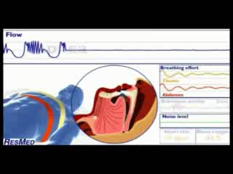
Repeated OSA Apneas & Arousals
© ResMed 2011. Used with Permission.
Notes:
Complete Narration: “The second part of the video shows what happens after breathing stops, and how the vicious cycle is repeated through the night.”
_________________________
Notes for trainers: This video shows the reaction of the brain and body to an apnea. Apneas can last for 10 seconds or more, during which a person’s heart rate and blood oxygen drop dramatically. This sends an alarm signal to the brain. The person gasps for air, leading to sudden movement. Brain activity increases and heart rate may double. In severe OSA, this cycle may be repeated hundreds of times a night. Module 7 (for managers) and Module 8 (for drivers) cover OSA in much greater detail.

Slide 42

OSA Risk Factors
Factors increasing risks:
  Obese and overweight
  Male
  >40 years old
  Family history
  Large neck size (>17” for men, >16” for women)
  Recessed chin, small jaw, and/or large overbite
Notes:
Complete Narration: “There are a number of distinctive risk factors and warning signs for OSA. Risks are higher for people who are obese or overweight. Rates are higher among males; those over 40; those with large neck sizes; people with recessed chins, small jaws, or large overbites; and those with a family history of OSA. “
_______
Notes for Trainers: OSA is often undiagnosed, even though the symptoms and risk factors are well-known and often obvious.
One study (Xie et al., 2011) found that obese individuals (BMI > 30) had a 29-fold increased OSA risk compared to non-obese individuals.
Training participants may want to discuss OSA. Do not pry into people’s medical conditions, but often participants will want to talk about them. You could ask if anyone in the group would like to talk about experiences with OSA. This might include symptoms, diagnosis, and treatment.

Slide 43
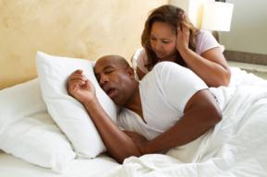
OSA Warning Signs
Behavioral warning signs:
  Excessive daytime sleepiness
  Snoring
Physical effects and warning signs:
  High blood pressure (hypertension)
  Diabetes
  OSA tends to worsen obesity
Notes:
Complete Narration: “Behavioral warning signs include excessive daytime sleepiness and snoring. Physical effects include high blood pressure and diabetes. OSA also tends to worsen obesity. Thus, obesity is both a risk factor for OSA and an effect of it.”
__________
Notes for trainers: OSA risk strongly correlates with these warning signs, but OSA must be confirmed by a sleep lab study, discussed in subsequent slides.

Slide 44

OSA & Driving
Studies suggest 2 to 7-fold crash risk
Can result in medical disqualification (although often undetected during qualifications process)
Estimated 28% of truck & bus drivers have mild to severe OSA
Notes:
Complete Narration: “OSA is often dangerous for driving, mainly because of drowsiness. Studies suggest a 2- to 7-fold increased crash risk. OSA can result in medical disqualification for commercial drivers, although it is often undetected during the qualification process. An estimated 28% of truck and bus drivers have mild-to-severe OSA.”
_______
Notes for Trainers: 2-7 fold crash risk estimate from National Sleep Foundation (Drobnich, 2007), based on studies of non-commercial drivers. These are case-control studies where OSA sufferers are compared to other drivers. The 28% incidence statistic is from Pack et al., 2002.

Slide 45
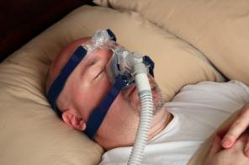
OSA Screening & Treatments
Screening
  Assessment of risk
  Sleep study
Treatments can be very effective if followed - examples:
  Continuous Positive Airway Pressure (CPAP) machine
  Weight reduction and behavioral changes
NAFMP Module 8 provides additional driver instruction
Notes:
Complete Narration: “OSA screening first involves assessment of a person’s risk based on the factors described. A person meeting the risk criteria should have a sleep study for a definite diagnosis. Treatments can be very effective, but only if they are followed. One standard treatment is use of a Continuous Positive Airway Pressure (or CPAP) machine during sleep. Another is weight reduction with behavioral changes, including better diet and exercise. Module 8 of this series provides additional driver education on OSA.”
______________
Notes for Trainers: Treatments are examples. There are others. CPAP is effective, but only if the treatment is followed faithfully. One night of non-use results in sleepiness the following day. Therefore, emphasize that treatments must be followed to be effective. As a discussion topic, you might ask if any students or their spouses use CPAPs. Do they work? What are the challenges using them. Many people will say that their health and life quality have been greatly improved by CPAP use, even if it is difficult.
Consider presenting Module 8 to family members as well as to drivers, if there is sufficient interest.

Slide 46

Insomnia
Trouble falling or staying asleep
Common, often related to stress
Usually not a medical condition, though it can be
Irony:
  Sleeping pills are often used to treat insomnia, yet
  Insomnia can be related to excessive use of sleeping pills
Good sleep hygiene behaviors reduce insomnia:
  Lower caffeine intake (amount and timing)
  Have a wind-down routine
  Completely darken bedroom
Notes:
Complete Narration: “Do you have trouble falling or staying asleep? You may suffer from Insomnia. Insomnia is common, and often related to daily stress. It is usually not a medical condition, though it can be. Here’s an irony about insomnia. Sleeping pills are often used to treat insomnia, but insomnia can be related to excessive use of sleeping pills. Good sleep behaviors reduce insomnia. Lower caffeine intake. Have a regular bedtime wind-down routine. Completely darken your bedroom using heavy curtains and no night lights.”
_______
Notes for Trainers: This is yet another topic where participants may want to talk about their experiences. The most important question is, “What works to reduce it? Sleep-related behaviors such as caffeine use are most important. Individuals with chronic insomnia should see their physicians, however.

Slide 47
Other Sleep Disorders
Restless Leg Syndrome
  Afflicts ~5% of adults
  Usually not serious
  Tingling or other leg discomfort causes excessive movement
  Cannot relax to sleep
Narcolepsy
  Sudden sleep when active
  Lasts a few seconds to 30 minutes
  Extremely dangerous, but rare
Many others (such as sleepwalking, abnormal circadian rhythms)
Notes:
Complete Narration: “You may have heard of other sleep disorders. Restless Leg Syndrome afflicts about 5% of adults. Usually it is not serious. In Restless Leg Syndrome, tingling or other leg discomfort causes excessive leg movement. Sufferers cannot easily relax to sleep. . . . Another sleep disorder is Narcolepsy. Narcoleptics fall asleep suddenly, often when they are active. Their sleep may last from a few seconds to 30 minutes. Narcolepsy is extremely dangerous, but fortunately it is rare. There are many other sleep disorders (including sleepwalking and abnormal circadian rhythms), but most are rare.”
_____________
Notes for trainers: Both Restless Leg Syndrome and Narcolepsy are treatable with drugs. Individuals with Narcolepsy would not likely be commercial drivers. It is a neurologic condition, not a breathing disorder like OSA.

Slide 48

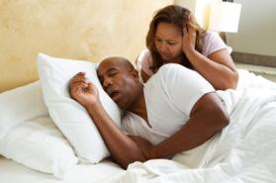
Key Sleep Disorder Symptoms
Excessive daytime sleepiness
Extremes in ability to go to sleep:
  Able to sleep almost immediately, almost anywhere
  Unable to sleep for a long time, even under ideal conditions
Loud, irregular snoring, especially with gasping
Notes:
Complete Narration: ”Different sleep disorders have different symptoms, but here are a few “red flags.” The first is excessive daytime sleepiness. Next are extremes in the ability to go to sleep, such as being able to sleep almost immediately, almost anywhere; or, at the other extreme, being unable to sleep for a long time, even under ideal conditions. Another key symptom is loud, irregular snoring, especially with gasping. Ask a family member to tell you whether you snore, and to describe it.
_______
Notes for Trainers: Most of these symptoms relate most to OSA. Question to probe learning: We mentioned two common treatments for OSA. Can students remember them? Are they effective? Answer: Common OSA treatments are nightly use of a Continuous Positive Airway Pressure or CPAP machine, and weight loss with behavioral changes. Yes, they are effective if followed.”

Slide 49
Lesson 3: Health & Alertness
Notes:
Complete Narration: “Now that we have heard about fatigue and sleep disorders, let’s see what steps you can take to ensure that your whole family practices healthy behaviors to keep everyone at their best.”
____________
Notes for Trainers:
Sections in this lesson:
Health & Wellness
Drugs & Medications
Improving Sleep & Alertness

Slide 50

Health & Wellness:
What’s in it for us?
How you look and feel
Alertness and performance while driving → SAFETY
Longevity on the job
Life expectancy
Some unhealthful behaviors about twice as common among commercial drivers as in general population
Notes:
Complete Narration: “Health and wellness – what’s in it for us? A lot! Your health affects how you look and feel. It affects alertness and performance while driving, and that in turn affects safety. It affects driver longevity on the job and, even more importantly, life expectancy. One study found some unhealthful behaviors and other indicators to be about twice as common among commercial drivers as in the general population. This included behaviors like smoking and behavior-related medical conditions like high blood pressure and diabetes.”
________________
Notes for trainers: We want drivers and families to feel ownership of both the problem and the benefits of improvement.
Study cited: Roberts and York (2000), study sponsored by the U.S. DOT and performed by the National Private Truck Council (NPTC). Examples of percentages cited in report:
Smoking: ~50% of truck drivers versus ~25% of general population.
Overweight: >70% of truck drivers versus ~32% of general population [in 1994; greater today]
High blood pressure: ~44% of truck drivers versus ~26% of general population.
Preliminary data from a 2011 National Institute of Occupational Safety & Health (NIOSH) survey (Siebert, 2012):
Smoking: 46% of truck drivers versus 21% of the U.S. population
Obese: 65% vs. 34%
“Fair” or “poor” health (self-reported): 18% vs. 10%.
Diabetes: 14% vs. 8%.

Slide 51
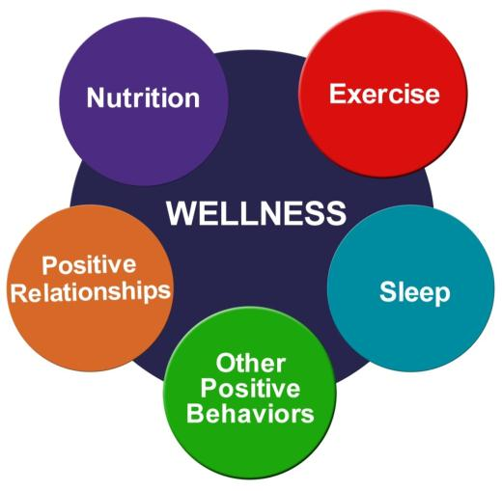
Personal Keys to Wellness
Notes:
Complete Narration: “There are at least five keys to wellness. Start with nutrition – a healthy diet. Other keys include exercise, sleep, other positive behaviors (like not smoking), and positive relationships. Changing your behavior in these five areas will bring personal wellness, better performance, and more happiness to your life.”
_______
Notes for Trainers: These five personal keys to wellness are addressed individually in the slides that follow.

Slide 52

Diet & Nutrition (1 of 2)
Too much food, fat, salt
Commercial drivers’ favorite foods: steak & burgers
Leading causes of death related to what people eat
Many fried and processed foods are not healthful
Good foods: grains, fruits, vegetables, low-fat milk products, lean meats, fish, nuts
Notes:
Complete Narration: “Let’s start with diet and nutrition. People today eat too much food, too much fat, and too much salt. One survey of commercial drivers found their favorite foods to be steaks and burgers! Most leading causes of death are related to what people eat. Many fried and processed foods are not healthful. Good foods include grains, fruits, vegetables, low-fat milk products, lean meats, fish, and nuts.”
_______
Notes for Trainers: This and some other keys to wellness are covered with a few points about the problem and then some suggestions for ways to improve. Survey cited: Holmes et al. (1996), in Krueger et al., (2007)

Slide 53

Diet & Nutrition (2 of 2)
Simple Behavioral Goals:
Strive for Five: 5 servings of fruit and vegetables daily
Replace bad fats (e.g., chips) with good fats (e.g., nuts)
Replace bad carbs (e.g., sweets, potatoes) with good carbs (e.g., whole grains)
Replace sweet drinks with water
Notes:
Complete Narration. “Set some simple behavioral goals for your diet. First, Strive for Five. That’s 5 servings of fruits and vegetables daily.
Replace bad fats (such as chips) with good fats (such as nuts). Replace bad carbs (for example, sweets and potatoes) with good carbs (such as whole grains). Also, replace sweet drinks with plain ole water.”
_______
Notes for Trainers: Some specific, simple behavioral goals. Ask participants whether they “strive for five” fruits and vegetables daily. Does it work?

Slide 54

Exercise (1 of 2)
Recommendation:
  2.5 hours per week aerobic exercise (like walking)
  + Muscle-strengthening workouts twice a week
Benefits:
  ↑Energy level and mood ↓Weight
  Improves sleep ↓ Stress
  Improves digestion ↓ Disease risk
Notes:
Complete Narration: “Next to diet, exercise is probably the most important wellness behavior. Health experts recommend 2 and 1/2 hours per week of aerobic exercise like walking, plus muscle-strengthening workouts such as weightlifting twice a week. Exercise raises your energy level and mood. It improves sleep and digestion. It reduces weight, stress, and disease risks. This includes diabetes, heart disease, osteoporosis, arthritis, and even some cancers.”
_______
Notes for Trainers: Commercial driving is usually sedentary. Most drivers need both aerobic and muscle-strengthening workouts. Module 5 includes material on Behavioral Self-Management and “SMART” goal-setting which are relevant to discussions about increasing exercise. Exercise recommendations from the U.S. Centers for Disease Control and Prevention.

Slide 55
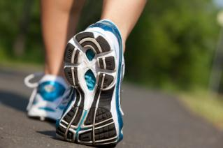
Exercise (2 of 2)
Strategies:
  10-minute walks twice or more per day
  Work out more vigorously on weekends
  Keep a record of your exercise
  Set daily & weekly goals
  Find out what you like and do it!
Notes:
Complete Narration: “Here are some strategies for getting more exercise. Take 10-minute walks twice or more per day. Work out more vigorously on weekends. Keep a record of your exercise; maybe just mark it on your calendar. Set daily and weekly goals. Include your whole family in a more active life style. Try new activities – bike rides, hiking nature trails, disc golf. Find out what you like and do it! ”
_________________________
Notes for Trainers: Strategies for getting more exercise. Do any participants maintain a record of their exercise? Keeping a record is one of the keys to increasing exercise.

Slide 56
Weight
  Commercial drivers:
    At least 50% are obese
    Another ~25% are overweight
Body-Mass Index (BMI) is a measure of how fat or thin you are
Being overweight increases many health risks
Solutions: diet & exercise
Calculate your BMI:
  (Weight/Height²) × 703 = BMI
  If BMI is: <25 = normal
    25-30 = overweight
    >30 = obese
Notes:
Complete Narration: “If you don’t exercise and eat a healthy diet, you are probably overweight. At least half of commercial drivers are obese and another 25% are overweight. Body-Mass Index, or BMI, is a measure of how fat or thin you are. You can figure yours by taking your weight in pounds, dividing it by your height in inches squared, and multiplying that by 703. A BMI of less than 25 is normal. 25 to 30 means you are overweight. A BMI above 30 means you are obese. Being overweight increases many health risks. There are just two good strategies for losing weight: diet and exercise.”
_________________
Notes for Trainers: Driver weight statistics and effects. If participants want to calculate their own BMIs, you may need to help them with the math. Determining BMI in the metric system is much easier; simply take your weight in kilograms and divide it by your height in meters, squared.
Additional information: Weight studies: Korelitz et al. (1993), Hickman et al. (in press). Also note 2011 NIOSH survey (Siebert, 2012) results cited earlier; i.e., commercial driver obesity and overweight statistics may be even worse than those cited here.
Additional fact: Obese drivers are less likely to wear safety belts, perhaps because belts are uncomfortable for them. This puts them at even greater risk. Source: Wiegand et al., 2008.

Slide 57
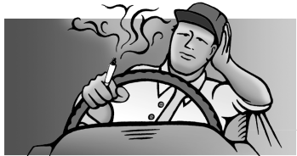
Smoking & Other Tobacco Use
Leading preventable cause of disease, death, & disability
Use:
  21% of Americans
  46% of commercial drivers
Causes:
  Lung cancer and disease
  Heart disease
  Many other medical conditions
  Can hurt your family’s health
Strategy: QUIT!!! See your doctor. Call 1-800-QUIT-NOW. Visit www.smokefree.gov or www.hc-sc.gc.ca for the quitline in your Province
Notes:
Complete Narration: “Smoking, along with other tobacco use, is the leading preventable cause of disease, death, and disability. About 21% of Americans smoke, but 46% of commercial drivers do. Smoking causes lung cancer, other lung diseases, heart problems, and many other medical conditions. Secondary smoke can hurt the health of your family members by increasing the risk of asthma and respiratory infections. Smoking costs each smoker on average more than $1,000 per year in medical costs. To quit, see your doctor. You can also call 1-800-QUIT-NOW or visit www.smokefree.gov. or www.hc-sc.gc.ca for the quitline in your Province.”
_______
Notes for Trainers: If a person smokes, quitting should be their #1 health priority. Medical cost data from American Lung Association. Smoking statistics based on 2011 NIOSH survey (Siebert, 2012).

Slide 58

Stress (1 of 2)
Symptoms:
Headaches
Sleep disturbances
Difficulty concentrating
Short temper
Upset stomach
Job dissatisfaction
Low morale
Notes:
Complete Narration: “You and your family know that commercial driving can be stressful! The job involves long hours, fighting traffic, schedule pressure, and isolation from family and friends. One study found truck driver stress to be higher than that of 90% of the population. Stress symptoms include headaches, sleep disturbances, difficulty concentrating, short temper, upset stomach, job dissatisfaction, and low morale.”
_______
Notes for Trainers: One study found truck driver stress to be higher than 90% that of the population. Study cited: Orris et al, 1997, in Roberts & York (2000).

Slide 59

Stress (2 of 2)
Strategies:
Positive outlook & behaviors
Balance between work and personal life
Pursue personal interests
Support network
Try to improve environment
Get serious about relaxing!
  Relaxation breathing
  Short walks
  Meditation
  Reading
  Find methods that work
Notes:
Complete Narration: “There are effective strategies to deal with stress. Embrace a positive outlook and positive behaviors. Strike a balance between work and your personal life. Pursue personal interests, especially those that involve physical or social activities. Find and sustain a support network of family, friends, and co-workers. Try to improve your home and work environment to make things better. Finally, get serious about relaxing! Learn about relaxation breathing and give it a try. Take short walks, meditate, read -- experiment until you find methods that work for the whole family.”
_______
Notes for Trainers: Strategies for stress reduction. Many of these are healthful in other ways as well.

Slide 60


Personal Relationships:
Family & Friends
Driver survey: Lack of family time was the biggest single health & wellness concern
Driver personal and family problems sometimes lead to unsafe driving and accidents
Families & friends can help!
  Keep in touch
  Value one another
  Do fun things together
  Be supportive
Notes:
Complete Narration: “One commercial driver survey found that lack of family time was the biggest single health and wellness concern. Therefore, make the most of the time you have together! On the negative side, driver personal and family problems sometimes lead to unsafe driving and to accidents. On the positive side, good relationships with family and friends can have many benefits. Work to improve these relationships. Keep in touch and communicate with each other. Value and foster each one another. Do fun things together, like family outings. Be positive, and show support.
_______________
Notes for trainers: While factors like poor diet, obesity, lack of exercise, and smoking have greater medical effects, lack of family time probably has greater psychological effects on drivers. That’s why families should take advantage of the time they have together. Survey: Roberts & York, 2000.

Slide 61

Caffeine
The most widely used stimulant
In coffee, tea, sodas, energy drinks, some medications
Generally safe and healthy if used in moderation
Improves both alertness and physical performance
Effects and tolerance vary widely for different people
Though effective, not a substitute for sleep
Notes:
Complete Narration: “Caffeine is the most widely used stimulant. Caffeine is found in coffee, tea, most sodas, energy drinks, and some medications. It is generally safe and healthy if used in moderation. Caffeine generally improves both alertness and performance. However, caffeine effects and tolerance vary widely for different people. Caffeine is effective in supporting alertness, but is not a substitute for sleep.”
_______
Notes for Trainers: Caffeine basics. People may be surprised to learn that caffeine is not unhealthful if used in moderation. Module 3 has more information on caffeine. For additional information on the behavioral effects of caffeine and other drugs, see Krueger et al. (2011).

Slide 62

Caffeine & Sleep
Like any stimulant, caffeine makes sleep more difficult
Generally, avoid caffeine within 6-8 hours of main sleep period
Effects vary - some people are even more sensitive
If you have trouble going to sleep:
  Reduce caffeine intake
  Increase time between last dose to bedtime
Notes:
Complete Narration: “Like any stimulant, caffeine makes sleep more difficult. Avoid caffeine within 6 to 8 hours of your main sleep period. Effects vary widely, and some people are even more sensitive. If you have trouble going to sleep, reduce your caffeine intake, and increase the time between your last dose and bedtime.”
_______
Notes for Trainers: Anyone using caffeine needs to find the amount and pattern of use that gives them alertness benefits without disrupting their sleep. Principal source: Krueger & Leaman, 2011.

Slide 63

Alcohol & Sleep
Some people use as sleep aid, and it usually does make you sleepy
But it actually disrupts sleep
Causes “rebound” awakening after a few hours
Makes OSA worse
Notes:
Complete Narration: “Then there is alcohol. Some people use alcohol as a sleep aid, and alcohol usually does make you sleepy. But it actually disrupts sleep. It can cause “rebound” awakening after a few hours. Maybe you have had the experience of drinking in the evening and later awakening 3 or 4 hours after going to sleep. Alcohol also makes OSA worse. Your throat tissue becomes more relaxed and thus closes more easily.”
_______
Notes for Trainers: As with caffeine, alcohol can affect different people differently. Alcohol use in the hours before bedtime is disruptive to sleep. These disruptive effects may increase with aging. Also note: Alcohol use by commercial drivers is rare as a primary cause of crashes.

Slide 64

Sleeping Pills
General categories:
  Non-prescription Over-The-Counter (OTC); e.g., Tylenol PM, Benadryl
  Prescription; e.g., Ambien, Sonata, Lunesta
Cautions:
  No sleeping pill provides 100% natural sleep
  Most have side effects
  Most are habit-forming (some with withdrawal symptoms)
  Follow dosage directions carefully!
Notes:
Complete Narration: “Many people use drugs to induce sleep, and some can be used safely. There are two general categories of sleeping pills. The first is non-prescription, Over-The-Counter drugs like Tylenol PM and Benadryl. And there are prescription sleeping pills like Ambien, Sonata, and Lunesta. Sleeping pills can be effective, but there are some important cautions. First, no sleeping pill provides 100% natural sleep. Most have side effects. Most are habit-forming , and some cause withdrawal symptoms. Follow dosage directions carefully!”
_______
Notes for Trainers: Sleeping pills can be helpful or harmful to sleep and wellness. Following dosage directions is critical. Module 3 has more information on sleeping pills.

Slide 65

Other Medications Have Fatigue Side Effects
Common side effects:
  Drowsiness
  Other fatigue
  Insomnia
Accordingly, many prescriptions specify when the drug should be taken (e.g., at bedtime)
Follow dosage instructions carefully
Notes:
Complete Narration: “Finally, other medications may have fatigue side effects, like drowsiness, other fatigue, or insomnia. Discuss drug side effects with your prescribing physician. Many prescriptions specify when the drug should be taken, such as at bedtime. Follow dosage instructions carefully.”
___________
Additional information: Fortunately, medication use per se is not known to be a major direct cause of crashes; but it can contribute to them. For example, most anti-anxiety drugs cause drowsiness, especially if combined with alcohol.

Slide 66

Driver Challenges (1 of 2)
Often a tight schedule for getting main sleep
Long work hours
(+ commuting for many)
Changing schedules
Work/sleep periods conflict with circadian rhythms
Limited time for naps and other rest
Notes:
Complete Narration: “Let’s talk about the fatigue management challenges faced by commercial drivers. These may include a tight schedule for getting one’s main sleep, long work hours (plus commuting time for many drivers), changing schedules, work and sleep periods which may conflict with circadian rhythms, and limited time for naps and other rest.”
______________
Notes for trainers: Not all of these challenges and difficulties apply to all drivers. In presenting this, you may want to mention any relative company policies and practices, such as those related to shift changes.

Slide 67

Driver Challenges (2 of 2)
Unfamiliar and/or uncomfortable sleep locations
Disruptions of sleep
Limited opportunities for exercise
Difficult to find healthy foods on the road
Environmental stressors (noise, heat, cold, lack of ventilation)
Notes:
Complete Narration: “Additional challenges faced by many drivers include unfamiliar or uncomfortable sleep locations, disruptions of sleep, limited opportunities for exercise, difficulty in finding healthy foods on the road, and environmental stressors like noise, heat, cold, and lack of ventilation. It’s tough to meet all these challenges.”
_____________________
Notes for trainers: Again, not all of these challenges and difficulties apply to all drivers. To the extent possible, present these as challenges to overcome, as opposed to obstacles that cannot be removed.

Slide 68

General Strategies to Meet
These Challenges
SLEEP!!!
  Anchor sleep
  Naps
Healthful lifestyle
Regular schedule
“Go with” your circadian rhythm
Be smart about caffeine use
Communicate and encourage each other
Notes:
Complete Narration: “Fortunately, there are some helpful strategies and practices. First and foremost, sleep! Get plenty of “anchor” sleep in your main sleep period, and take naps. Maintain a healthful lifestyle, including diet, exercise, positive behaviors, and positive relationships. To the extent possible, try to keep a regular schedule. Go with your circadian rhythm – don’t fight it. Be smart about caffeine use – learn what’s right for you. It takes teamwork to be healthy – within your family, communicate and encourage each other to do the right things.”
_______
Notes for Trainers: These general strategies apply both at home and on the road. Earlier slides provided more detail. In regard to schedule regularity, be prepared to discuss both forward and backward schedule rotations, and the reasons backward rotations are disadvantageous for fatigue management.

Slide 69

Getting Good At-Home Sleep
Recognize the key role of family
Bedroom should be:
  Cool
  Quiet
  Completely dark
Pre-sleep routine:
  “Gear down”
  Lower lights
Be active & have fun, but don’t exhaust yourself! Take time to relax
Notes:
Complete Narration: “Good sleep starts at home. Recognize the key role of family members. For starters, your bedroom should be cool, quiet, and completely dark. Develop a pre-sleep routine. “Gear down” before bedtime and lower the lights. Be active and have fun, but don’t exhaust yourself! Take time to relax.”
________________
Notes for trainers: This slide also recaps information and suggestions provided earlier in the module.

Slide 70

Daytime Sleeping
Difficult for adults:
  Daytime circadian arousal
  Alerting effects of light
  Noise, interruptions
  Competing demands
To improve daytime sleep:
  Pre-sleep wind down
  Completely dark bedroom
  Eyeshades & earplugs
  Respect driver’s need to sleep as a family priority
Notes:
Complete Narration: “The driver in your family may need to sleep during the daytime. Daytime sleeping is difficult for most adults. Both sleep quality and quantity are affected. Causes for poor daytime sleep include the natural circadian arousal that occurs during daytime, alerting effects of light, noise, interruptions, and competing daytime demands such as household chores. But there are ways to improve daytime sleep. Adopt a pre-sleep wind-down routine, just as you would for night sleeping. You need a completely dark bedroom -- buy and install special curtains if necessary. Eyeshades and earplugs also help. The bedroom must be quiet. Remove the telephone and keep household noises down. Everyone must respect the driver’s need to sleep as a family priority.”
_______
Notes for Trainers: Daytime sleeping at home is especially difficult for drivers with families, especially young children. Ask participants if drivers must sleep during the day when they are home and, if so, which strategies are most helpful.

Slide 71

Critical At-Home Times for Drivers
Just before a trip. Driver needs a good night’s sleep!
Just after a trip. Driver needs to relax, unwind, and sleep
Notes:
Complete Narration: “The most critical at-home times for drivers are often the very same times when they are busiest. Just before leaving on a trip, a driver needs a good night’s sleep. And just after returning from a trip, a driver needs to relax, unwind, and sleep. Keep these needs in mind when planning your weekends.
_______
Notes for Trainers: Critical at-home times for drivers – just before a trip and just after a trip. Are these times stressful for families? Do families have any “rules” or practices they use to make these times easier?

Slide 72
Conclusion: Review and Summary
Notes:
“We’re almost done! Here is a brief review of what we have discussed.”
Notes for trainers: This final, short section reviews a few key terms and then makes concluding remarks.

Slide 73
Review: Fatigue-Related
Terms & Concepts (1 of 2)
Alertness
Wellness
Fatigue
Acute vs. chronic fatigue
Microsleeps
Sleep deprivation: performance and health effects
Sleep debt
Recovery
“Regular” & REM Sleep
Notes:
Complete Narration: “Here are some of the fatigue-related terms and concepts we have covered. Take a moment to review them.”
_______
Notes for Trainers: In classroom training, read these out loud and ask whether there are questions. Ask them questions such as, “What is the difference between acute and chronic fatigue? How do they relate to each other? What is a microsleep? Etc.

Slide 74
Review: Fatigue-Related
Terms & Concepts (2 of 2)
Circadian rhythms
Time awake
Individual differences in fatigue susceptibility
Sleep disorders
Obstructive Sleep Apnea
Insomnia
Health & wellness
Drugs & medications
Critical at-home times
Notes:
Complete Narration: “And how about these? If you see a term or concept that you don’t remember, feel free to go back to review.”
_______
Notes for Trainers: More terms and concepts. Possible review questions include: Describe REM sleep. Name several causes of individual differences in fatigue susceptibility. Is OSA an illness? (Yes, a very serious one!). Is insomnia an illness? (Not usually. Most often it can be reduced by relatively simple changes in behavior.)

Slide 75


Home & Family
Sleep is a biological need
Sleep and other health-related behaviors affect performance and quality of life
Home and family are the foundation for driver wellness and safety
Notes:
Complete Narration: “So what have we learned today? We have learned that sleep is a biological need. Sleep and other health-related behaviors affect both performance and quality of life. When your family works together to promote healthful behaviors, everyone wins! After all, home and family are the foundation for driver wellness and safety.”
____________
Notes for trainers: No new information; rather just recapping fundamental points made earlier. The key goal here is attitude change.

Slide 76
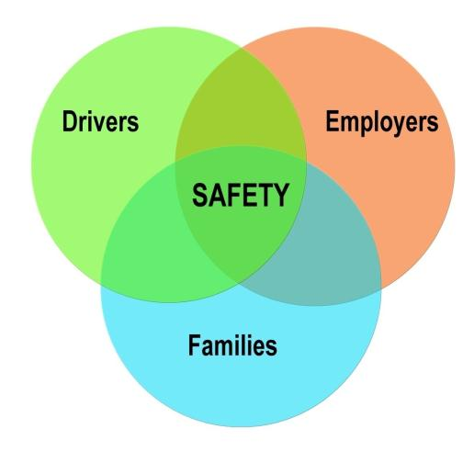
Drivers, Families, & Employers:
Working Together for Driver Safety!
Notes:
Complete Narration: “The North American Fatigue Management Program is based on a team concept: Drivers, families, and employers all working together for driver safety. Thanks for taking the time to view this training module – we appreciate your commitment and support.”
_______
Notes for Trainers: The module closes with this schematic reinforcing the team concept behind enlightened fatigue management. Families are a big part of the team!

Slide 77
Module 4 Exam
Notes:
Narration: “Want to test yourself on what you have learned? The optional exam contains ten multiple choice questions. [Additional instructions on taking exam.]
_______
Notes for Trainers: The Module 4 exam is optional and family member scores should not be recorded. But some will see it as a fun challenge, and taking it will reinforce their learning. After you have administered the test, go over the questions and the correct answers.

